Slide 1
Game 3
Your Value to a Game

Slide 2
Your Value to a Game
You:
Director of a commercial-free music video channel
Streaming services pay to carry you
You make a take-it-or-leave-it offer
Streaming Services:
Each channel has $100K in value
Streaming services have varying capacities (k)
Select the k lowest price requests
Market 1: 50 Market 2: 30 Market 3: 20

Slide 3
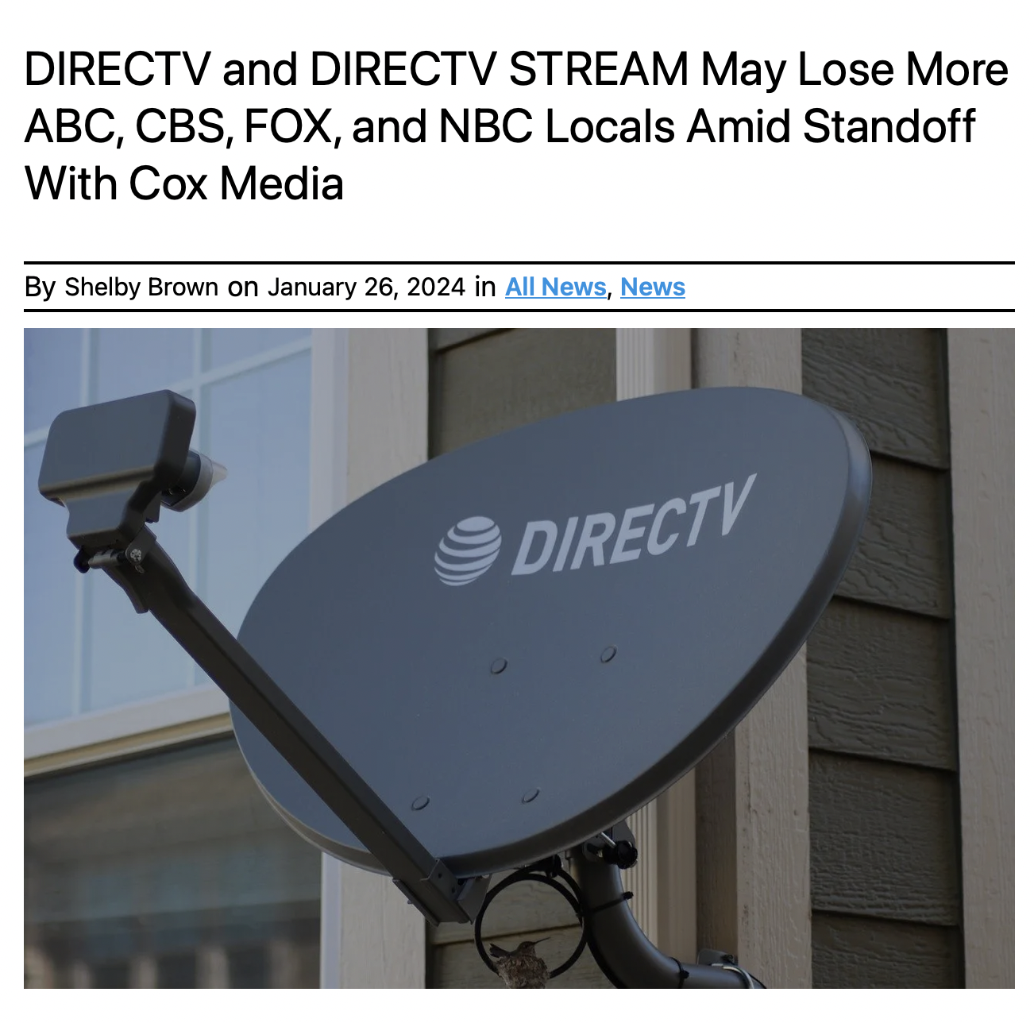

Slide 4
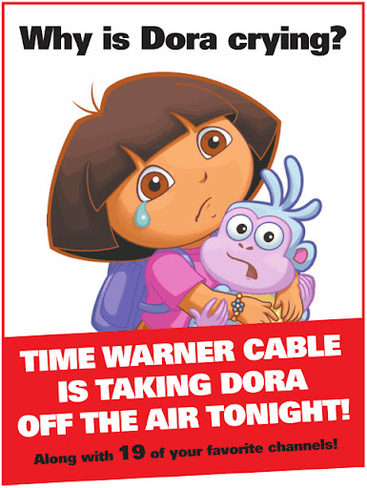
Full page ad in
The New York Times

Slide 5
Your Value to a Game
Your added value =
the size of the pie
when you are in the game
minus
the size of the pie
when you are not

Slide 6
Unlimited Capacity (k=50)
What is your value to the game?
What is the total value of the game?
How much should you be paid to play?

Slide 7
Class Results
Most requested $100,000
Or $99,000
But some LOVE the streaming services
A number requested less than $50,000
One requested $25
One requested $0
What is the total value of the game?
How much should you be paid to play?

Slide 8
Slightly Limited Capacity (k=30)
What is your value to the game?
What is the total value of the game?
How much should you be paid to play?

Slide 9
Limited Capacity
(k=20)
What is your value to the game?
What is the total value of the game?
How much should you be paid to play?

Slide 10
Payoff Summary
 | k = 50
Average offer: | 71
Accept offers below: | 100
Average accepted offer: | 71
My profit per channel: | 29
My profit: | x 35 = 1015
 |  | k = 30
 |  | 48
 |  | 75
 |  | 43
 |  | 57
 |  | x 30 = 1710 (+68%)
 |  |  | k = 20
 |  |  | 23
 |  |  | 24
 |  |  | 10
 |  |  | 90
 |  |  | x 20 = 1800 (+77%)

Slide 11
Intuition
By reducing capacity
I lower your added value
I gain bargaining power
I get a better price per channel
I gain higher profits overall
But:
The value of the game is smaller

Slide 12
Best Scores
maximum profit = 100 + 75 + 24 = 199
Four people: 100 + 75 + 50 = 175
One person: 100 + 75 + 40 = 175

Slide 13
Others
Swinging for the fences
George 100 + 99.970 + 99.980 = 100
Playing it safe
Aaron 95 + 20 + 10 = 125
Playing it very safe
Griffin 15 + 7.5 + 2.5 = 25

