Slide 1
Game Theory
Spring 2024 - Mike Shor Topic 1

Slide 2
“Only the paranoid survive.”
– Andy Grove
Co-founder of Intel

Slide 3
What is Game Theory?
“No man is an island, entire on itself”
— John Donne, 1624
Game theory is the study of rational behavior in interdependent situations.
A game is any situation where the outcome of your actions depends on the actions of others

Slide 4
Games We Play

Slide 5
Games Economists Play
Collusion (OPEC) free-riding
Standards setting coordination
Market entry commitment
Business tax breaks prisoner’s dilemma
Tax compliance strategic randomization
Product announcement bluffing
Renewable resources congestion
Used goods markets information manipulation

Slide 6
Strategic Randomization (Mixed Strategies)
Games
governments play: IRS audits
businesses play: Employee drug testing
sports teams play: Run or pass?
defense departments play: Where and when to attack
politicians play: Campaign expenditures
nature “plays”: Make poison or pretend?

Slide 7
Real-Life Games
Different from board games, card games, video games, sports, computer games
Not win-lose: possible for all to win (or lose)
Apart from law & ethics, there is no rule book
Others change the game to their advantage
Success comes from playing the right game

Slide 8
Why Study Game Theory?
Bad news:
  Knowing game theory does not guarantee winning.
Good news:
  Framework for thinking about strategic interaction.
Predict outcomes before the game is played
Manipulate rules (within legal & ethical boundaries) to give yourself an advantage

Slide 9
Why Study Game Theory?
“Game theory is hot”
— The Wall Street Journal
Students trained in game theory work for:
financial firms
public policy firms
strategy consultancies
gvt. regulatory agencies
political campaigns
pricing divisions
intelligence agencies
HR departments
the military
sports teams

Slide 10
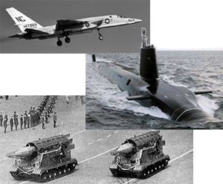
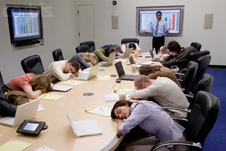
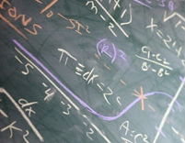
A Brief History

Slide 11
Administratrivia

Slide 12
Course Information
Textbook
  None required
Course web site
  Check after each lecture

Slide 13
Course Outline
Recognizing the Game
Simultaneous games
  Anticipating rivals’ moves
Sequential games
  Looking forward and reasoning back
Mixed strategies
  Strategic unpredictability
Repeated games
  Cooperation and deterrence

Slide 14
Course Outline
Winning the Game
Strategic Moves
  Credibility, threats, and promises
Information
  Signaling & screening, incentive pay
Bargaining & Auctions
  participating and designing

Slide 15
Online Games
Participate by midnight each Sunday
No preparation required; games are timed
Scores & decisions are made public
Opponents are not
Not graded (but required!)
Discuss what you did and why
Academic integrity: check if participated

Slide 16
Quizzes & Problems
Six quizzes (one dropped, best five count)
Optional Homework assignments
Extra Credit
  Game theory is everywhere!
  Find it (and email it to me)

Slide 17
Grading
Midterm 20%
Final Exam 35%
Quizzes (and assignments) 25%
Class participation 10%
Games (participation) 10%

Slide 18
Interactive
Decision Theory
Decision Theory: You are goal-driven when considering your options
Game Theory: So is everyone else

Slide 19
Ten of you go to a restaurant
If each pays for own meal…
This is a decision problem
If you all agree to split the bill...
Now, this is a game

Slide 20
Interactive
Decision Theory
Never assume that people’s behaviors are fixed.
Predict their reaction to your behavior.

Slide 21
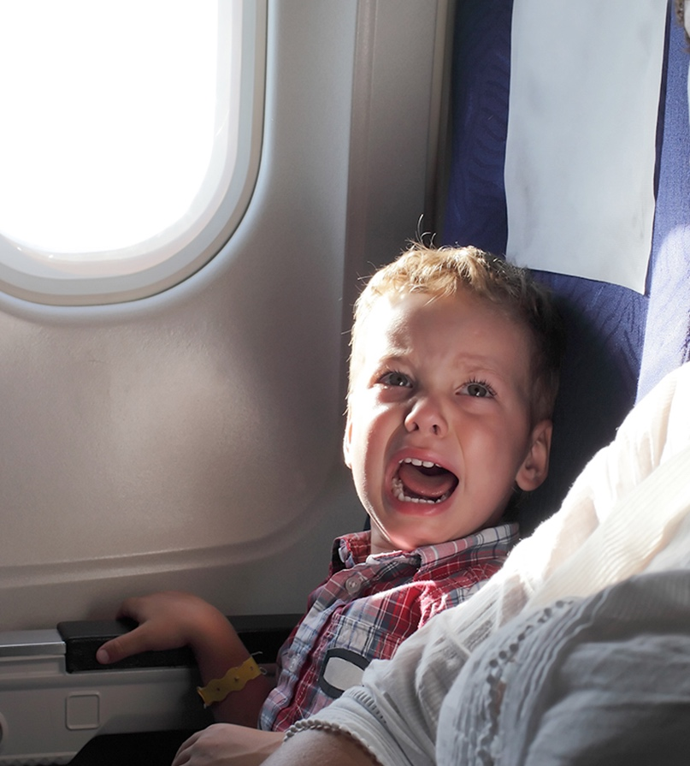
Lap children
Are children on an airplane safer in a parent’s lap
or in their own seat?

Slide 22
Understanding Incentives
Why extra customer capacity can be bad
  Can you be better off throwing some of your goods away prior to trading with someone?
Why cannibalize your own sales?
  Can developing a product that only competes with other products you own ever be good?
Where is it better to have a car break down?
  Are you more likely to get someone to stop and help on a busy street or a deserted one?

Slide 23
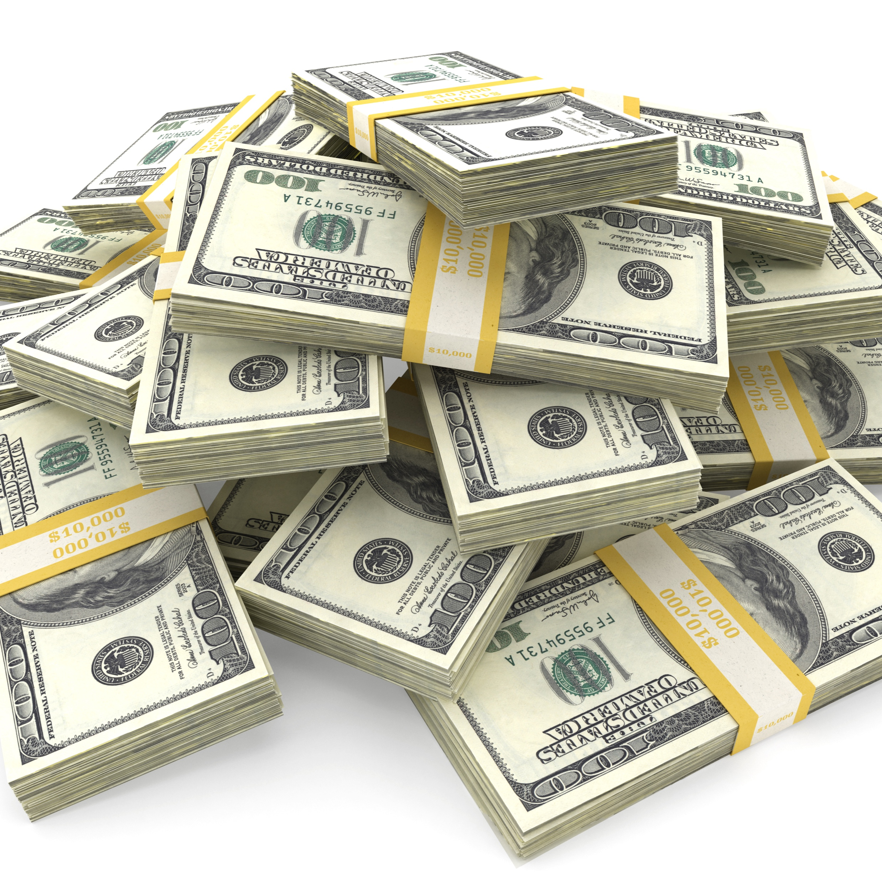
$
Free Money
Pick an option:
Option 1: $50
Option 2: $40
Option 3: $20

Slide 24
Incentives
Spend as much time thinking about your
opponents’ actions as you do your own!
Up next:
The rules of the game
The assumptions of game theory

Slide 25
Review
Interactive decision theory
Strategic interdependence of players
You pursue your goals
So does everyone else
Your actions change incentives for others

Slide 26
I don’t skate to where the puck is.
I skate to where the puck
is going to be.
– Wayne Gretzky
NHL record goal scorer

Slide 27
Outline
Defining the rules of the game
  Manipulating the rules if they are flexible
  Questioning game theory’s assumptions

Slide 28
Components of a Game
Participants
                Rules
  Assumptions
Players (who)
                Strategies (what)
  Payoffs (why)
  Timing (when)
  Information (when)
  Rationality
  Common Knowledge

Slide 29
Participants
Players
(who?)
                Everyone who impacts your earnings
                Everyone whose actions you care about

Slide 30
Participants
Strategies
(what?)
                A comprehensive plan of action for every contingency in a game
                An action specifies a move at a specific stage of a game
                A strategy specifies an action for every possible decision a player can face

Slide 31
Participants
Payoffs
(why?)
                Numbers associated with each outcome, reflecting interests of the players
                Sometimes just ordinal
                (A is better than B)
                Sometimes need cardinal
                (A is twice as good as B)

Slide 32
Rules
Information
Timing
(when?)
              Who knows what and when?
              Are moves simultaneous or sequential?
                This is an information distinction (not a timing distinction)

Slide 33
Changing the Rules
Are the rules of the game fixed or flexible?

Slide 34

Example: Agenda Setting
Graduation Speaker
Bernie Sanders,
Donald Trump, or
Elizabeth Warren?
Decided by nine-person
committee by majority rule

Slide 35
Agenda Setting
No majority in three-way race
Committee president sets voting rules:
First, Bernie v. Donald
    Then, Bernie/Donald winner versus Elizabeth
First, Donald v. Elizabeth
    Then, Donald/Elizabeth winner versus Bernie
First, Elizabeth v. Bernie
    Then, Elizabeth/Bernie winner versus Donald

Slide 36
Agenda Setting
Recall member preferences:
4 (B>D>E) 3 (D>E>B) 2 (E>B>D)
Majority rule results:
    B beats D ; D beats E ; E beats B
Voting results:
    B vs. D then winner versus E
    D vs. E then winner versus B
    E vs. B then winner versus D
→
→
→

Slide 37
Changing the Rules
When the rules of the game are flexible,
manipulate them to your advantage.

Slide 38
The battle is won
before it is ever fought.
– Sun Tzu

Slide 39

Assumptions
Rationality
Common Knowledge

Slide 40
Assumptions
Rationality
              Players aim to maximize their payoffs
              Players are perfect calculators
              Players know their own payoffs
              Players never make mistakes

Slide 41
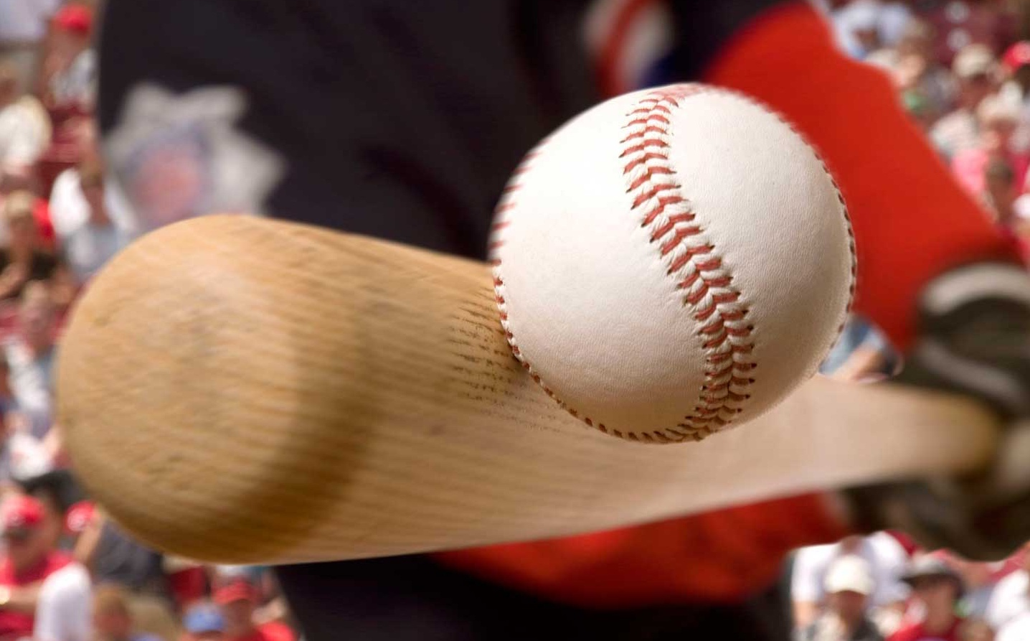
Baseball rationality
What is the optimal angle
to hit a baseball?
(If hitting for distance)

Slide 42
Assumptions
Common Knowledge
              Each player knows
              & Each player knows that each player knows
              & Each player knows that each player knows that each player knows
              & Each player knows that each player knows that each player knows that each player knows
              & Each player knows that each player knows that each player knows that each player knows that each player knows
              & Each player knows that each player knows that each player knows that each player knows that each player knows that each player knows
              & Each player knows that each player knows that each player knows that each player knows that each player knows that each player knows that each player knows
              & Each player knows that each player knows that each player knows that each player knows that each player knows that each player knows that each player knows that each player knows
              & Each player knows that each player knows that each player knows that each player knows that each player knows that each player knows that each player knows that each player knows that each player knows
              & Each player knows that each player knows that each player knows that each player knows that each player knows that each player knows that each player knows that each player knows that each player knows that each player knows
              Etc. Etc. Etc.

Slide 43
Assumptions
  Knowledge: I know (some information) X
      Mutual knowledge: Each of us knows X
      Common knowledge: Each of us knows that each of us knows … that each of us knows X
              We assume that
              players, strategies, payoffs, rules, and each player’s rationality are common knowledge

Slide 44
Common Knowledge
Do people really behave
as the theory predicts?
If not, what good is the theory?

Slide 45
Common Knowledge
Behavioral game theory:
The rule of three
Game theory:
The rule of infinity
Example: the stock market

Slide 46
I can calculate the motions
of heavenly bodies,
but not the madness of people
– Sir Isaac Newton
upon losing £20,000 in the South Sea Bubble in 1720

Slide 47
Common Knowledge
If a crystal ball showed everyone the exact date of the next stock market crash, when would you sell?

Slide 48
IPO Lock-up
A company wishes to “go public”
  It offers to sell shares to the public
  Typically, only 20% of shares are offered
  The remainder are held by “insiders”
Lock-up
  Precludes insiders from selling shares,
  typically for six months
What happens when the lock-up expires?

Slide 49
Increased supply after the lock-up expiration will drive price down. It is simply economics of supply and demand.
– Wall Street Journal reporter

Slide 50
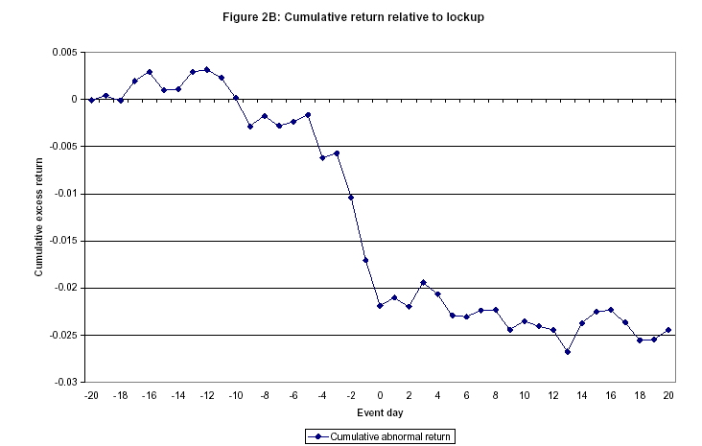
Stock Returns around IPO Lock-up Expiration
0.005
0
-0.005
-0.010
(Cumulative Abnormal)
Return
-0.015
-0.020
-0.025
-0.030
-20
-16
-12
-8
-4
0
4
8
12
16
Lock-up Expiration

Slide 51
Summary
Every strategic interaction is a game
The rules are likely to be flexible
Think one step ahead
The rule of three steps
Next:
Equilibrium: What are the outcome of games?

