Slide 1
Game 1
The P-Beauty Contest

Slide 2
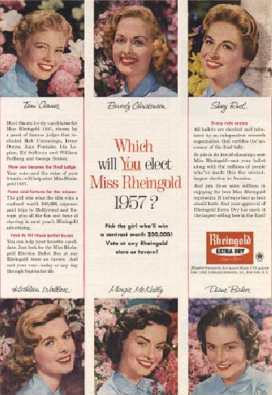
P-Beauty Contests

Slide 3
Levels of Rationality

Slide 4
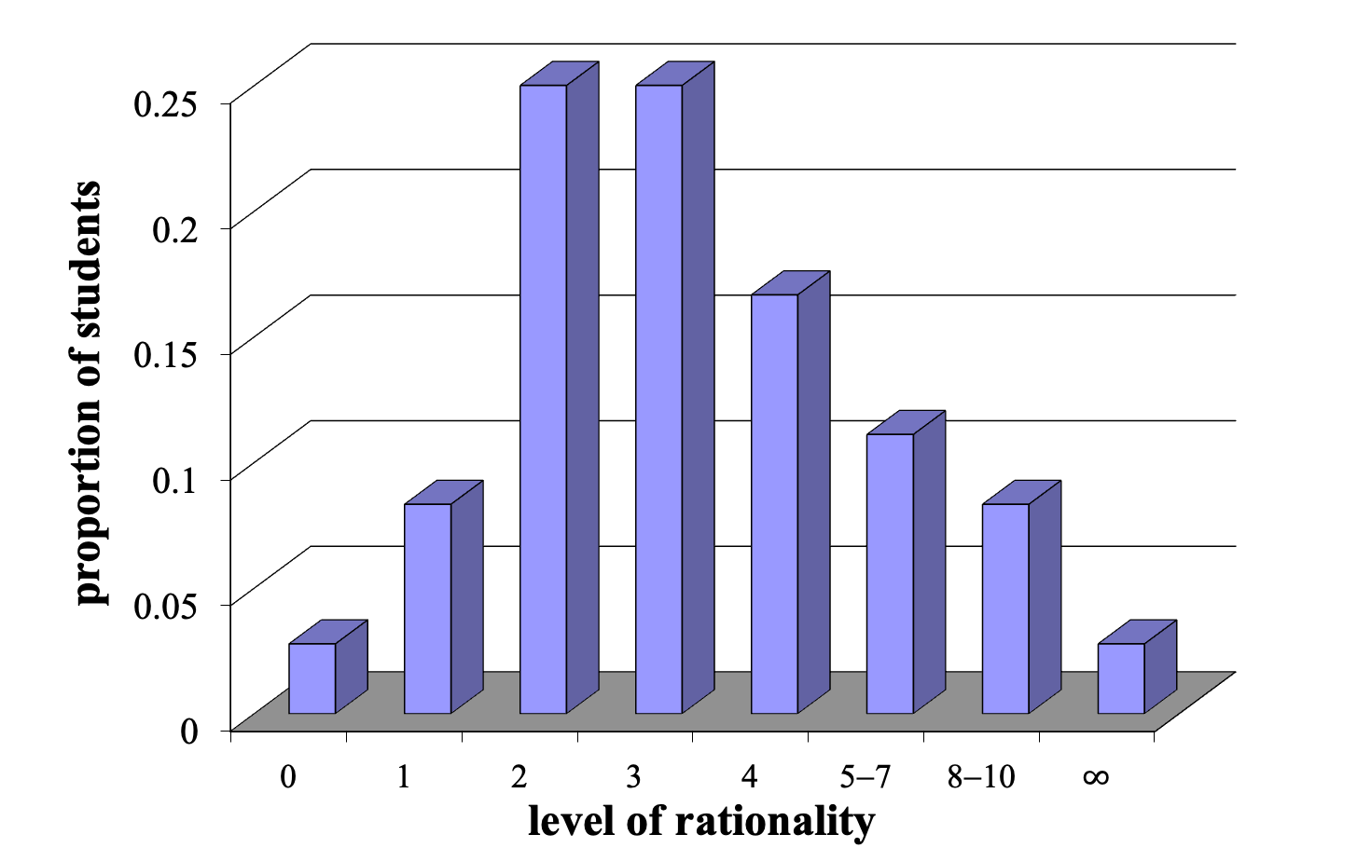
Class Strategies

Slide 5
Levels of Rationality
2-3
Penn (Wharton) Students
Cal-Tech’s Board of Trustees
US High School Students

Slide 6
Levels of Rationality
2-3
Penn (Wharton) Students
Cal-Tech’s Board of Trustees
US High School Students
UConn

Slide 7
Levels of Rationality
2-3
3
Penn (Wharton) Students
Cal-Tech’s Board of Trustees
US High School Students
UConn
Cal-Tech undergrads

Slide 8
Results
Average Number: 39.1
¾ of Average: 29.3

Slide 9
Closest
Ayesha 30
Carter 30

Slide 10
Furthest
One person picked: 100
One person picked: 74

Slide 11
I’m Rational
(but the rest of you aren’t)
Jake 2

Slide 12
Predictability
Winning Number: 29.3

Slide 13
Predictability
Winning Number: 29.3
2024 30.7

Slide 14
Predictability
Winning Number: 29.3
2024 30.7
2023 30.4
2022 29.8
2019–2021 30.2
2016–2018 29.7
2013–2015 29.6

Slide 15
Summary
Common knowledge is bunk
Bounded rationality is not
Understand how far reasoning of other players will go
People generally think two to three steps ahead
(The rule of three)
Need to stay one step ahead
Don’t be too clever

Slide 16
