Slide 1
The p-Beauty Contest
Game 1

Slide 2
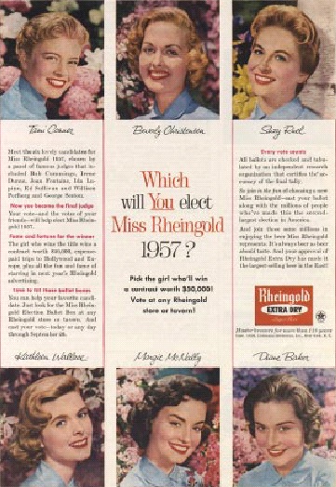
P-Beauty Contests Historically

Slide 3
“We have reached the third degree where we devote our intelligences to anticipating what average opinion expects the average opinion to be. And there are some, I believe, who practice the fourth, fifth and higher degrees.”
John Maynard Keynes

Slide 4
Levels of Rationality
Number Chosen

Slide 5
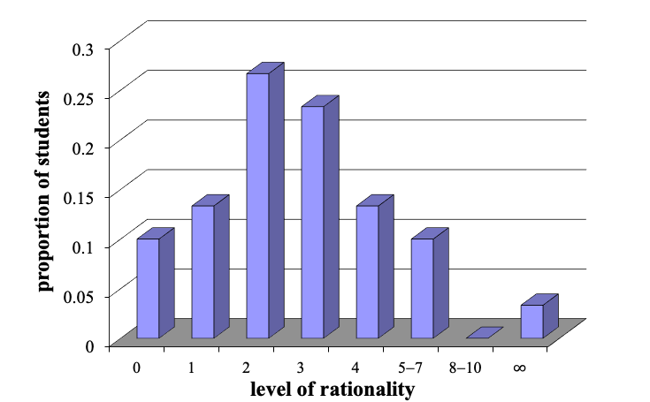
Class Strategies

Slide 6
Levels of Rationality
2-3
US High School Students
Penn (Wharton) Students
Corporate CEOs
Number Chosen

Slide 7
Levels of Rationality
2-3
US High School Students
Penn (Wharton) Students
Corporate CEOs
UConn
Number Chosen

Slide 8
Class Results
Average Number: 40.6
Winning Number: 30.4

Slide 9
Closest
Kishan 30
Joseph 31
Evan 29
Top ten gave answers between 23 and 37.5

Slide 10
Farthest
One person 91
One person 85

Slide 11
Farthest
Kevin 4

Slide 12
Predictability
Winning Number: 30.4

Slide 13
Predictability
Winning Number: 30.4
Other Section: 30.7

Slide 14
Predictability
Winning Number: 30.4
Other Section: 30.7
2025–2026: 30.6

Slide 15
Predictability
Winning Number: 30.4
Other Section: 30.7
2025–2026: 30.6
2022–2025: 30.4
2019–2022: 30.2
2016–2019: 29.7
2013–2016: 29.6

Slide 16
Summary
Common Knowledge:
  an infinite number of steps
Bounded Rationality:
  People generally think 2–3 steps ahead
  Need to stay one step ahead of that

Slide 17
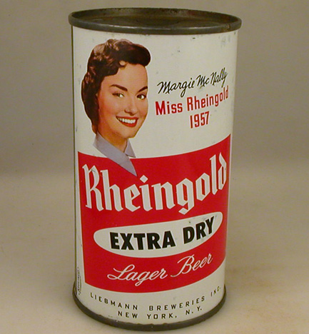
Miss Rheingold
1957

