Slide 1
Game 7
Repeated Games

Slide 2
Opponent “Personalities”
Tit-for-Tat
Tit-for-Two-Tat
Grim Trigger Strategy
Random
Equilibrium

Slide 3
Opponent “Personalities”
Tit-for-Tat
Cooperate → Cooperate Defect → Defect
Tit-for-Two-Tat
Cooperate → Cooperate Defect twice → Defect
Grim Trigger Strategy
Cooperate → Cooperate Defect → Defect forever
Random
Flip a coin: Heads → Cooperate / Tails → Defect
Equilibrium
Defect, Defect, and then Defect some more

Slide 4
Highest / Lowest Payoffs
maximum minimum
Tit-for-Tat 20 +0.4 10 +0.8
Tit-for-Two-Tat 25 +0.2 10 +1.6
Grim Trigger 20 +0.4 10 +0.8
Random 20 (avg) 10 (avg)
Equilibrium 10 0
95 +1.0 40 +3.2

Slide 5
Highest / Lowest Payoffs
maximum Tit-for-Tat
Tit-for-Tat 20 +0.4 20 +0.4
Tit-for-Two-Tat 25 +0.2 20 +0.4
Grim Trigger 20 +0.4 20 +0.4
Random 20 (avg) 15 (avg)
Equilibrium 10 10 - 0.4
95 +1.0 85 +0.8

Slide 6
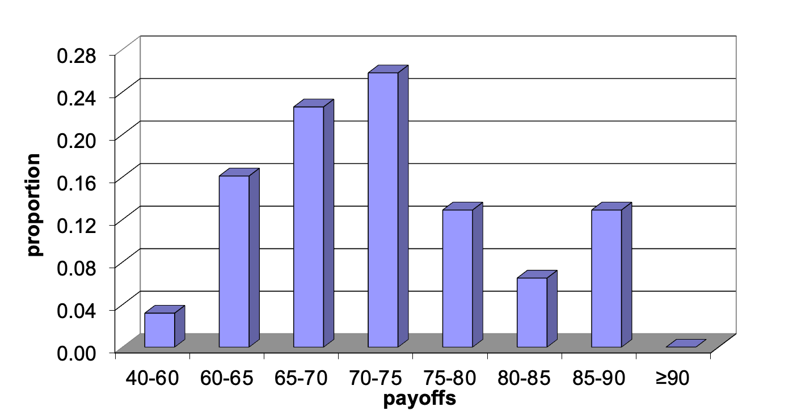
Class Results
Random
Tit-for-tat

Slide 7
Grading on a Curve
Score between 0 and 100
How close are you to one of these two benchmarks?
Random: 61 (low) → 0
Tit-for-tat: 86 (high) → 100
(Note: always defect earns 64 → 12)

Slide 8
Highest Scores
Jack 106
John 103
Marta 100

Slide 9
And…
Shanmathi 0
Landon 4
Naichka 4

Slide 10
And…
Jake –13

Slide 11
The Flip Side
How my evil opponents did against the class
(best to worst)
Tit-for-Tat ( F N P C )
Grim Trigger Strategy ( N P C )
Equilibrium (Cheater) ( C )
Tit-for-Two-Tat ( F N )
Random ( )

