Slide 1
Introduction
Game
Theory
  ECON 3208
Topic 1
Fall 2026 · Mike Shor

Slide 2
“Only the paranoid survive.”
Andy Grove
Co-founder of Intel

Slide 3
What is Game Theory?
Does your best move depend on what someone else does? If yes, you’re in a game.
Game theory is the study of rational behavior in interdependent situations
A game is any situation where the outcome of your actions depends on the actions of others

Slide 4
Games
We
Play

Slide 5
Games Economists Play
Algorithmic rent-setting
Standards setting
Entry deterrence
Tax breaks for crypto
Tax enforcement
Overfishing
Used car markets
Product announcement
free-riding
coordination
commitment
prisoner’s dilemma
strategic randomization
congestion
information manipulation
signaling

Slide 6
Strategic Randomization
  mixed strategies
Games
governments play
businesses play
sports teams play
generals play
politicians play
nature “plays”
IRS audits
random drug testing
run or pass?
where to attack?
campaign advertising
poison or mimicry?

Slide 7
Real-Life Games
  not like board games
Real-life strategic interactions are unlike board games, card games, video games, or sports
Not necessarily win-lose: all may win (or lose)
No rule book, apart from law and ethics
Players change the game to their advantage
Success comes not just from playing well, but from playing the right game

Slide 8
Why Study Game Theory?
Bad news
Game theory does not guarantee winning
Good news
Game theory provides a framework for thinking about strategic interaction
Predict outcomes before the game is played
Change the rules to change the outcome
  (within legal and ethical boundaries)

Slide 9
Why Study Game Theory?
  “Game theory is hot!”
  — Wall Street Journal
  Nobel winners:
  1994
  2005
  2007
  2012
  2020
Students trained in game theory work for:
technology platforms
financial institutions
consulting firms
government agencies
defense & intelligence
online ad auctions
pricing divisions
public policy firms
human resources
political campaigns
sports teams
AI labs

Slide 10

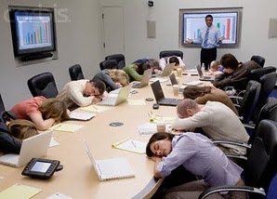

A Brief History

Slide 11
Administratrivia
“Please read the syllabus”
– Every professor ever

Slide 12
Course Information
Textbook
  None required
Course web site
  Slides, readings, sample problems, and games
  Check after each lecture
HuskyCT
  Announcements and game standings

Slide 13
Course Outline
  Recognizing the game
Introduction
Simultaneous games
Sequential games
Mixed strategies
Repeated games
Anticipating rivals’ moves
Looking forward and reasoning back
Strategic unpredictability
Cooperation & deterrence

Slide 14
Course Outline
  Changing the game
Strategic Moves
Information
Auctions
Credibility, threats, and promises
Signaling, screening, incentive pay
Participating and designing

Slide 15

Games
Most weeks, last few minutes of class
  Occasionally assigned outside class, played online
No preparation required
Decisions & outcomes are made public
Opponents are not
Not graded on the outcome
Register on the course web site by Wednesday
Academic integrity: treat like exam or quiz

Slide 16
Electronics-Free Classroom
  no laptops, tablets, or phones
Not for notes either
  Obviously, CSD accommodations are excepted
Why: attention is a scarce resource
  Most of what we do is conceptual
  Thinking, discussion, and decisions
Slides are posted before class
  Bring a printed copy if you want one in front of you

Slide 17
Class Participation
  name tents
Bring and display a name tent every class
  Take it with you, or leave it with me
Want to be left alone occasionally?
  Don’t display your name tent that day
  No explanation needed

Slide 18
Quizzes
Six topic quizzes
  lowest grade dropped, best five count
First 10–15 minutes of class (be on time!)
Format reviewed in the prior class
Practice:
  online sample problems and self-tests

Slide 19
Grading
Midterm 20%
Final Exam 35%
Quizzes 25%
Class participation 10%
Games 10%
87+ B+ 77+ C+ 67+ D+
93+ A 83+ B 73+ C 63+ D
90+ A- 80+ B- 70+ C- 60+ D

Slide 20
Honors
  section 003, or converting
Come see me in the first three weeks
  Individually or in a small group
The aim is something you actually want to work on
  Not busy work
Honors work can count for up to 20% of your grade

Slide 21
Interactive Decision Theory
Decision theory: you have goals
Game theory: so does everyone else

Slide 22
Splitting the Bill
  Decision theory vs. Game theory
Ten of you go to a restaurant
If each pays for own meal…
This is a decision problem
If you all agree to split the bill...
Now, this is a game

Slide 23
Splitting the Bill
  Decision theory vs. Game theory
Check-splitting policy changes incentives!

Slide 24
Interactive Decision Theory
Never assume that people’s behavior is fixed.
Predict their reaction to your behavior.

Slide 25

Lap Children
Are children on an airplane safer in a parent’s lap, or in their own seat?

Slide 26
Understanding Incentives
  three puzzles
Capacity Paradox
  Can destroying some of your product make you better off?
Cannibalization Puzzle
  Can launching a product that only steals share from your other products be good?
Breakdown Dilemma
  Are you more likely to get help on a busy street or a deserted one?

Slide 27
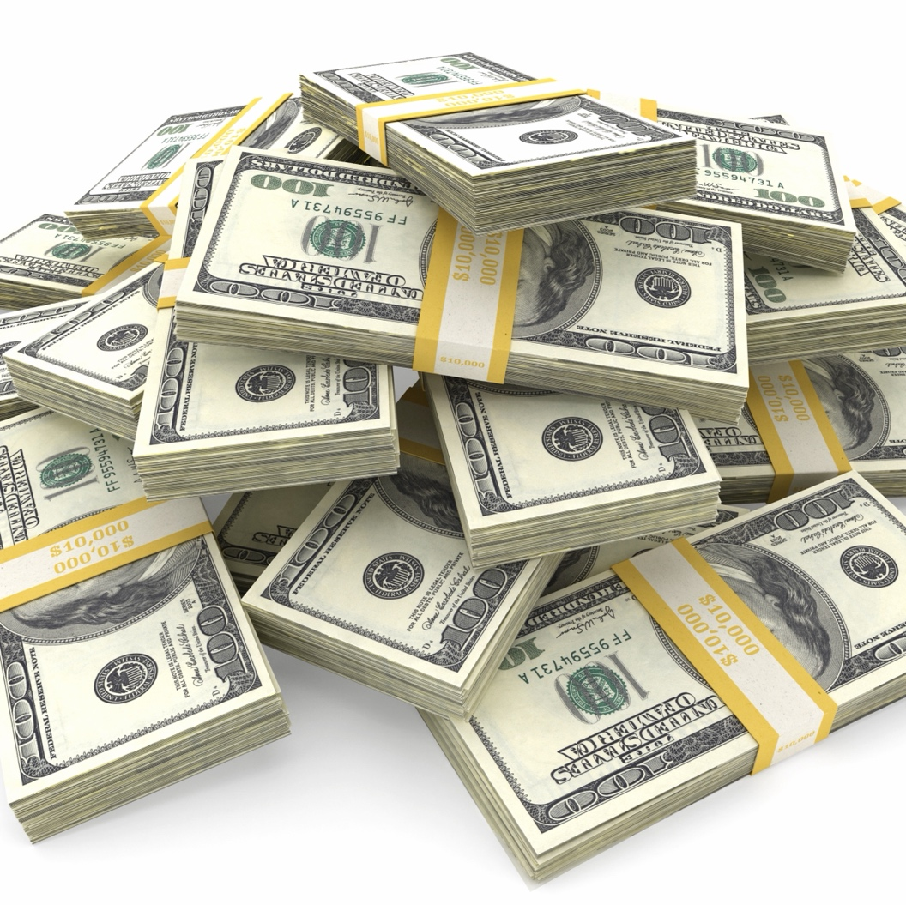
Free Money
Option 1: $50
Option 2: $40
Option 3: $20

Slide 28
Incentives
Spend as much time thinking about your opponents’ actions as you do your own.
Up next:
The rules of the game
The assumptions of game theory

Slide 29
Game 1

