Slide 1
Review
Interactive decision theory
  Strategic interdependence of players
  Everyone’s choices affect others
You pursue your goals
So does everyone else
Your actions change the incentives of others

Slide 2
“I don’t skate to where the puck is. I skate to where the puck is going to be.”
Wayne Gretzky
NHL all-time points leader

Slide 3
Outline
Defining the rules of the game
Changing the rules if they are flexible
Questioning game theory’s assumptions

Slide 4
Components of a Game
Participants
Rules
Assumptions
Players
Strategies
Payoffs
Timing
Information
Rationality
Common knowledge
(who?)
(what?)
(why?)
(when?)
(when?)

Slide 5
Players
  the “who?”
Everyone whose actions you care about
Everyone who impacts the outcome

Slide 6
Strategies
  the “what?”
A comprehensive plan of action for every possible decision in a game
  including those you don’t expect to reach
Action:
  a move chosen at a specific stage of a game
Strategy
  an action for every decision a player can face

Slide 7
Payoffs
  the “why?”
Numbers attached to each outcome reflecting players’ interests
  Whatever they care about
Sometimes ordinal:
  “A is better than B”
Sometimes cardinal:
  “A is twice as good as B”

Slide 8
Information & "Timing"
Who knows what, and when?
Do we interact once or multiple times?
Are moves simultaneous or sequential?
  This is an information distinction, not a timing one
Simultaneous:
  All players make decisions without knowing the decisions of others

Slide 9
Changing the Rules
Are the rules of the game fixed or flexible?

Slide 10
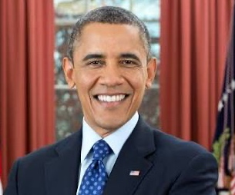
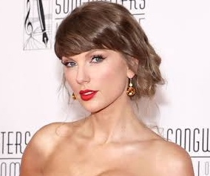
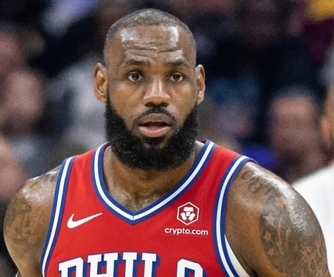

Agenda Setting
Who should be this year’s graduation speaker?
Barack Obama Taylor Swift LeBron James
Decided by a nine-person committee by majority rule (at least 5 of 9 must agree)

Slide 11
Agenda Setting
Who should be this year’s graduation speaker?
Barack Obama, Taylor Swift, or LeBron James
Nine-person committee, majority rule
4 prefer Barack > LeBron > Taylor
3 prefer LeBron > Taylor > Barack
2 prefer Taylor > Barack > LeBron
No majority in a three-way race

Slide 12
Agenda Setting
No majority in a three-way race
First Barack v. LeBron
  then the winner versus Taylor
First LeBron v. Taylor
  then the winner versus Barack
First Taylor v. Barack
  then the winner versus LeBron

Slide 13
Agenda Setting
Member preferences:
  4 (B>L>T) 3 (L>T>B) 2 (T>B>L)
Majority Preferences:
  B over L L over T T over B
B vs L then the winner versus T
L vs T then the winner versus B
T vs B then the winner versus L

Slide 14
When the rules are flexible, change them to your advantage.
Changing the Rules
“The battle is won before it is ever fought.”
Sun Tzu

Slide 15
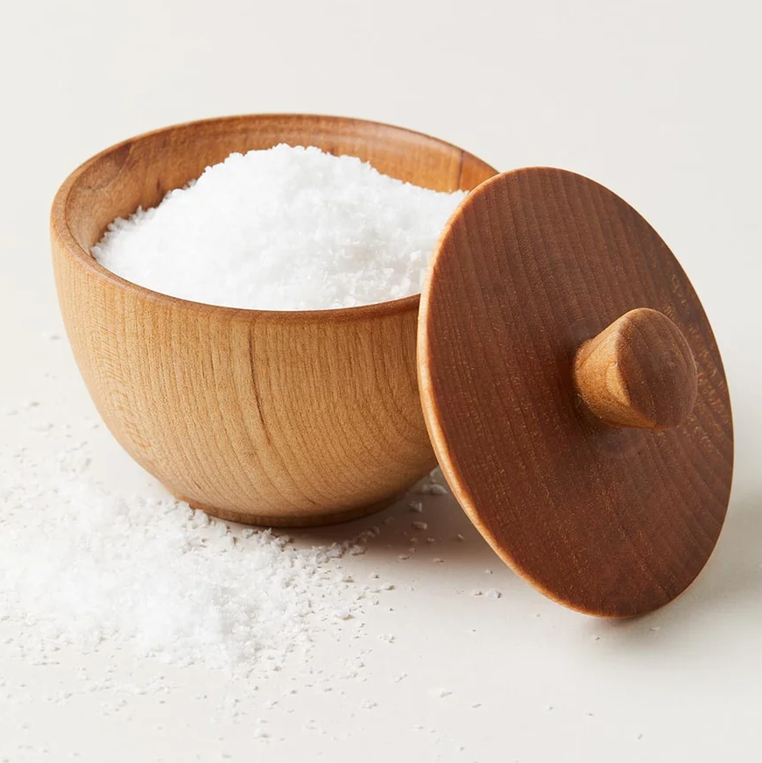
Assumptions
  two of them
Rationality
Common Knowledge

Slide 16
Rationality
Players aim to maximize their payoffs
Formally:
  Players are perfect calculators
  Players never make mistakes
  Players know what they want

Slide 17
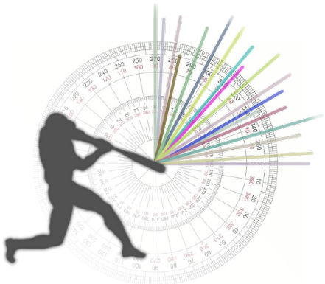
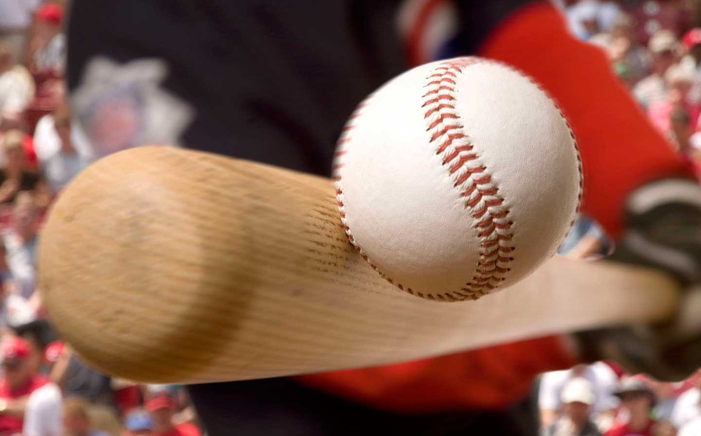
Baseball Rationality?
What is the optimal angle to hit a baseball?
  (If hitting for distance)

Slide 18
Rationality
The assumption of rationality is not about how people think
It is about how people act

Slide 19
Common Knowledge
  three kinds of knowing
Knowledge: I know X
Mutual knowledge: Each of us knows X
Common knowledge: Each of us knows X,
& each of us knows that each of us knows X,
& each of us knows that each of us knows that each of us knows X,
              & each of us knows that each of us knows that each of us knows that each of us knows X,
              & each of us knows that each of us knows that each of us knows that each of us knows that each of us knows X,
              & each of us knows that each of us knows that each of us knows that each of us knows that each of us knows that each of us knows X,
              & each of us knows that each of us knows that each of us knows that each of us knows that each of us knows that each of us knows that each of us knows X,
              & ach of us knows that each of us knows that each of us knows that each of us knows that each of us knows that each of us knows that each of us knows that each of us knows that each of us knows X,
              & each of us knows that each of us knows that each of us knows that each of us knows that each of us knows that each of us knows that each of us knows that each of us knows that each of us knows that each of us knows X,
              & each of us knows that each of us knows that each of us knows that each of us knows that each of us knows that each of us knows that each of us knows that each of us knows that each of us knows that each of us knows that each of us knows that each of us knows that each of us knows X
              and so on to infinity

Slide 20
Common Knowledge
  what we assume
Common knowledge: each player knows that each player knows that each player knows … to infinity
We assume that players, strategies, payoffs, rules, and each player’s rationality are common knowledge

Slide 21
Common Knowledge
ALT 9 — the GAME chip also marks "we are about to test this on you"
Do people really behave as the theory predicts?
If not, what good is the theory?

Slide 22
Common Knowledge
  theory versus practice
Behavioral game theory: the rule of three
  People reason 2-3 steps ahead
Game theory:
  People reason an infinite number of steps
Example: the stock market

Slide 23
“I can calculate the motions of heavenly bodies, but not the madness of people.”
Sir Isaac Newton (attributed)
on losing £20,000 in the South Sea Bubble, 1720

Slide 24
Common Knowledge
If a crystal ball showed everyone the exact date of the next market crash,
when would you sell?

Slide 25
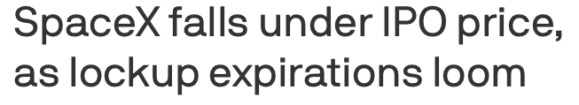
IPO Lock-up
  a real common-knowledge problem
IPO:
  A company goes public
  It offers shares to the public
  typically about 20%; rest are held by “insiders”
Lock-up:
  Insiders cannot sell, typically for six months
What happens when the lock-up expires?

Slide 26
“Increased supply after the lock-up expiration will drive price down.
It is simply economics of supply and demand.”
The Wall Street Journal

Slide 27
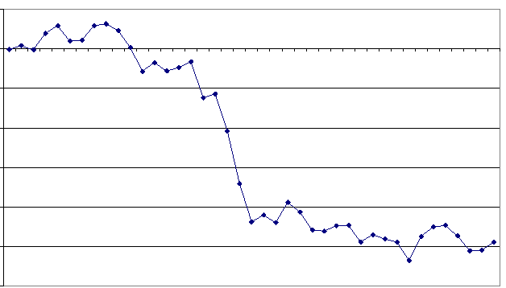
Stock Returns
  around lock-up expiration
0.005
0
-0.005
-0.010
(Cumulative Abnormal)
Return
-0.015
-0.020
-0.025
-0.030
-20
-16
-12
-8
-4
0
4
8
12
16
Lock-up Expiration
Notes:
Artwork placeholder — the chart runs the full height of the right-hand area.

Slide 28
Summary
  topic 1
If your best move depends on someone else, you’re in a game
The rules are usually very flexible
Think one step ahead of others
Others think 2–3 steps ahead
Next: equilibrium
what is the outcome of a game?

Slide 29
Game 2

