Slide 1
Game Theory
Spring 2025 - Mike Shor Topic 3

Slide 2
“It is true that life must be understood backward, but … it must be lived forward.”
– Søren Kierkegaard

Slide 3
Review
Understanding the outcomes of games
  Sometimes easy (dominant strategies)
  Sometimes tedious (best replies)
What if the games are sequential?

Slide 4
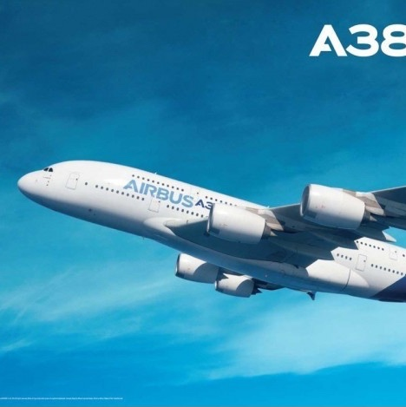
Very Large Airplanes
Airbus
versus
Boeing

Slide 5
Boeing, the world’s top aircraft maker, announced it was building a plane with 600 to 800 seats, the biggest and most expensive airliner ever.
— BusinessWeek, 1993

Slide 6
Airbus Profit Scenarios
Don’t Build
  If Boeing doesn’t: $0
  If Boeing builds: −$1 billion
Build
  If Boeing doesn’t: $0.3 billion
  If Boeing builds: −$4 billion

Slide 7
$0, $0
don’t
build
don’t
– $1 billion, – $1 billion
Airbus
$0.3 billion, – $3 billion
build
don’t
build
Boeing
– $4 billion, – $4 billion

Slide 8
Look Forward…
Airbus makes the first move:
    Must consider how Boeing will respond
don’t
don’t
Boeing
Boeing
build
build

Slide 9
…And Reason Back
Now consider the first move:
don’t
$0, $0
don’t
Airbus
build
don’t
$0.3 billion, – $3 billion
Boeing

Slide 10
Outcome
Only (Airbus build, Boeing don’t) make sense sequentially.
Boeing build is not rational

Slide 11
$0, $0
Checking Assumptions
don’t
build
don’t
– $1 billion, + $1 billion
← ?
Airbus
$0.3 billion, – $3 billion
build
don’t
build
Boeing
– $4 billion, – $4 billion

Slide 12
Nash Equilibria are Deceiving
  Two equilibria (game of chicken)
  But only one is sequentially rational
 |  | Boeing
 |  | Don’t | Build
Airbus | Don’t | 0 , 0 | -1 , 1
 | Build | 0.3 , -3 | -4 , -4

Slide 13
Boeing, the world’s top aircraft maker, announced it was building a plane with 600 to 800 seats, the biggest and most expensive airliner ever.
Some in the industry suggest
Boeing’s move is a bluff to preempt Airbus
from going ahead with a similar plane.
— BusinessWeek, 1993

Slide 14
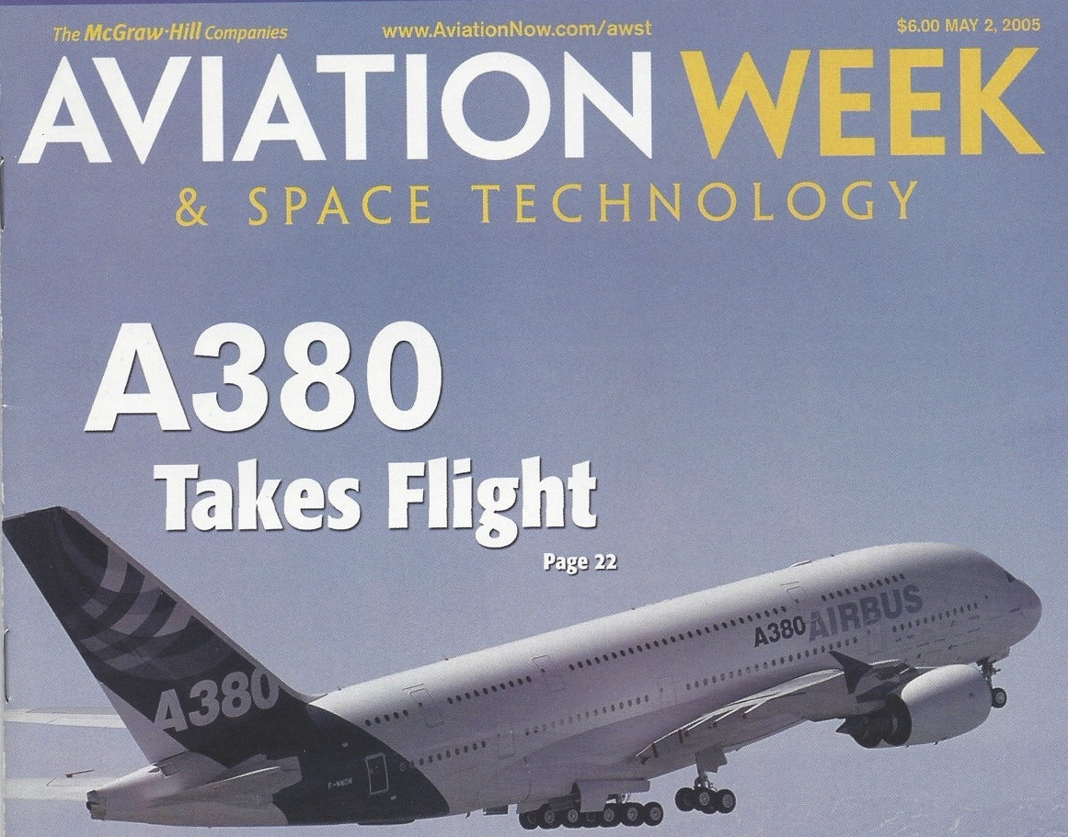
A380
Enters service in 2007
Singapore to Sydney
List price: $445 million
Next strategy: Go after Boeing 737s

Slide 15
Sequential Games
Look forward and reason back

Slide 16
Solving for Equilibria
Pick a last move
1. What player is making the decision?
2. What actions are available to that player?
3. What are the player’s payoffs from each decision?
4. Select the highest
  5. Place an arrow on the selected branch
  6. Delete all other branches
  Repeat: pick a last move
Continue until you reach the beginning

Slide 17
Subgame Perfect Equilibrium
Subgame perfect equilibrium (a.k.a. rollback or backwards induction equilibrium) is the equilibrium for sequential games
Start at the end and trim the tree to the present. Eliminate non-credible future actions.
Specifies an action at every decision node

Slide 18
Nash Equilibria are Deceiving (part II)
 |  | Player 2
 |  | X | Y
Player 1 | Less | 10 , 0 | 30 , 30
 | More | 20 , 20 | 40 , 10
Does either player have a dominant strategy?
What is the equilibrium?
What if Player 1 goes first?

Slide 19
Solving Sequential Games
Thinking backwards is easy in game trees
Thinking backwards is challenging in practice
Outline:
  Strategic moves in early rounds
  The rule of three (again)
  Seeing the end of the game

Slide 20

Agenda Setting Revisited
Graduation Speaker
Ned Lamont,
Jeff Bezos, or
Kamala Harris?
Decided by nine-person
committee by majority rule

Slide 21
Agenda Setting Revisited
Recall member preferences:
4 (N>J>K) 3 (J>K>N) 2 (K>N>J)
Majority rule results:
    N beats J ; J beats K ; K beats N
Voting results (example):
    N vs. J then winner versus K → K

Slide 22
N
N
N vs. K
Agenda Setting
as a Sequential Game
K
N
K
N vs. J
J
J
J
K
J vs. K
K

Slide 23
Looking Forward…
N
N
N vs. K
A majority prefers K to N
K
K
J
J
A majority prefers J to K
K
J vs. K
K

Slide 24
…And Reasoning Back
Four committee members
prefer N to J to K.
How should they vote
in the first round?
N vs. K
K
N
K
N vs. J
J
J
J
J vs. K

Slide 25
Sequential Games
Look forward and reason back
Anticipate what others will do tomorrow
in response to your actions today

Slide 26
Agenda Setting
Recall member preferences:
4 (N>J>K) 3 (J>K>N) 2 (K>N>J)
Majority rule results:
    N beats J ; J beats K ; K beats N
Voting results (example):
    N vs. J then winner versus K → K
    J vs. K then winner versus N → N
    K vs. N then winner versus J → J
⧸ J
⧸ K
⧸ N

Slide 27
Potential Entrant
Do you enter?
Do you accommodate entry?
What if there are fifty potential entrants?

Slide 28
Survivor Immunity Challenge
There are 21 flags
Players alternate removing 1, 2, or 3 flags
The player to take the last flag wins

Slide 29
1
grow
2
grow
3
grow
4
grow
Unraveling
•••
take
take
take
take
3, 1
2, 6
9, 3
4, 12
97
grow
98
grow
99
grow
100
grow
202, 202
•••
take
take
take
take
291, 97
98, 294
297, 99
100, 300

Slide 30
Unraveling
Equilibrium:
  take , take , take , take , take , …
  take , take , take , take , take , …
Remember:
    An equilibrium specifies an action at every decision node
    Even those that will not be reached in equilibrium

Slide 31
Potential Entrant
You have a monopoly market in every state
There is one potential entrant in each state
They make their entry decisions sequentially
Each time, you can accommodate or fight
What do you do the first year?

Slide 32
Looking Forward…
In the last period:
out
$0, $100 + previous
E
acc
50, 50 + previous
in
M
fight
–50, –50 + previous

Slide 33
…And Reasoning Back
The Incumbent will not fight the last entrant
But then, no reason to fight previous entrant
Only one sequential equilibrium
  All entrants play In
  Incumbent plays Accommodate
But for long games, this is mostly theoretical
People “see” the end two to three periods out!

Slide 34
Breakfast Cereals
A small sampling of the Kellogg’s portfolio

Slide 35
product development costs: $1.2M per product
600
500
400
sales (in thousands)
300
200
100
000
1
2
3
4
5
6
7
8
9
10
11
less sweet
more sweet

Slide 36
600
500
400
sales (in thousands)
300
200
100
000
1
2
3
4
5
6
7
8
9
10
11
less sweet
more sweet

Slide 37
SCENARIO 1
Profit = ½ 5(600) – 1200 = 300
600
500
400
sales (in thousands)
300
200
100
000
1
2
3
4
5
6
7
8
9
10
11
less sweet
more sweet

Slide 38
SCENARIO 2
Profit = 300 x 2 = 600
600
500
400
sales (in thousands)
300
200
100
000
1
2
3
4
5
6
7
8
9
10
11
less sweet
more sweet

Slide 39
SCENARIO 3
Profit = 300 x 3 – 240 x 2 = 420
600
500
400
sales (in thousands)
300
200
100
000
1
2
3
4
5
6
7
8
9
10
11
less sweet
more sweet

Slide 40
SCENARIO 4
Profit = 300 x 2 – 240 = 360
600
500
400
sales (in thousands)
300
200
100
000
1
2
3
4
5
6
7
8
9
10
11
less sweet
more sweet

Slide 41
Line Item Veto
Who benefits if the president can
pick and choose
what parts of a bill to veto?

Slide 43
Strategic Voting
We saw that voting strategically rather than honestly can change outcomes
Other examples?
    Centrist voting in primaries
    Crossing over in open primaries
    Amendments to make bad bills worse

Slide 44
Strategic Voting
Perhaps “majority rule” is a bad rule?
Can other rules eliminate “strategic voting”?
    Ranking of all candidates
    Proportional representation
    Runoffs
    Etc.

Slide 45
Arrow’s Impossibility Theorem
Desirable properties of a voting rule:
If everyone prefers A to B, B can’t win
If A beats B and C in a three-way race,
then A beats B in a two way race
Arrow’s Impossibility Theorem:
The only political procedure that always guarantees the above strategy is a dictatorship
No other voting system avoids strategic voting

Slide 46
Summary
Thinking forward misses opportunities
Make sure to see the game through to its logical end
Don’t expect others to see the end until it is close (the rule of three steps)

