Slide 1
Game Theory
Spring 2025 - Mike Shor Topic 4

Slide 2
“I used to think I was indecisive – but now I’m not so sure.”
– Anonymous

Slide 3
Review
Predicting likely outcome of a game
  Sequential (Look forward and reason back)
  Simultaneous (Look for simultaneous best replies)
What if (seemingly) there are no equilibria?

Slide 4

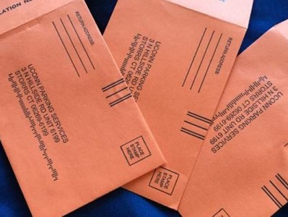
Parking at UConn
When to park illegally?

Slide 5
Odds or Evens
 |  | Evens
 |  | 1 | 2
Odds | 1 | -1 , 1 | 1 , -1
 | 2 | 1 , -1 | -1 , 1

Slide 6
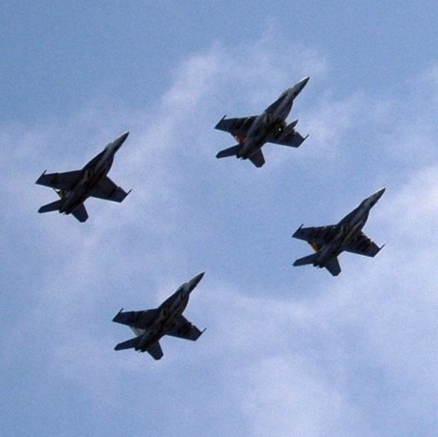
Air Defenses
Defend the North
or the South?

Slide 7
Mixed Strategies
Your optimal strategy makes your opponent indifferent between her strategies.

Slide 8
Employee Monitoring
Employees can work hard or shirk
    Salary: $100K unless caught shirking
    Cost of effort: $50K
Managers can monitor or not monitor
    Value of employee output: $200K
    Profit if employee doesn’t work: $0
    Cost of monitoring: $10K

Slide 9
Manager
 |  | No Monitor | Monitor
Employee | Work | 50 , 100 | 50 , 90
 | Shirk | 100 , -100 | 0 , -10
Best replies do not correspond
No equilibrium in pure strategies
What do the players do?

Slide 10
Nash Equilibrium
John Nash proved that every (finite) game has a Nash equilibrium.
We have to allow for randomization, or the use of mixed strategies.

Slide 11
Mixed Strategies
A mixed strategy assigns a probability (or frequency) to each pure strategy

Slide 12
Equlibrium
A player chooses her strategy so as to make her opponent indifferent.
If done right, the other player earns the same payoff from either of her strategies.

Slide 13
Employee Monitoring
Manager
 |  | No Monitor | Monitor
Employee | Work | 50 , 100 | 50 , 90
 | Shirk | 100 , -100 | 0 , -10

Slide 14
Solving for Equilibrium
Assign a probability to one strategy (e.g., p)
Assign remaining probability to other strategy (e.g., 1-p)
Calculate opponent’s expected payoff from each of the opponent’s strategies
Set them equal

Slide 15
Equilibrium Payoffs
 | 1/2 No Monitor | 1/2 Monitor
9/10Work | 50 , 100 | 50 , 90
1/10Shirk | 100 , -100 | 0 , -10
= 50(1/2)
+ 50(1/2)
= 50
= 100(1/2)
+ 0(1/2)
= 50
= 100(9/10)
-100(1/10)
= 80
= 90(9/10)
- 10(1/10)
= 80

Slide 16
Cycles
work
1
9/10
p
shirk
0
0
1/2
1
no monitor
q
monitor

Slide 17
Mutual Best Responses
work
1
9/10
p
shirk
0
0
1/2
1
no monitor
q
monitor

Slide 18
New Scenario
What if costs of monitoring increased to 50?
Manager
 |  | Monitor | No Monitor
Employee | Work | 50 , 50 | 50 , 100
 | Shirk | 0 , -50 | 100 , -100

Slide 19
New Scenario
To make employee indifferent:

Slide 20
Football
You have a balanced offense
Equilibrium:
Run half of the time; Run half of the time
Defense
 |  | Run | Pass
Offense | Run | 0 , 0 | 5 , -5
 | Pass | 5 , -5 | 0 , 0

Slide 21
Football
Your running game improves
What is the equilibrium?
Defense
 |  | Run | Pass
Offense | Run | 1 , -1 | 8 , -8
 | Pass | 5 , -5 | 0 , 0

Slide 22
Payoff Changes
Direct Effect:
Strategic Effect:
Strategic effect sometimes stronger
  The player benefitted should take the better action more often
  Opponent defends against my better strategy more often, so I should take the better action less often

Slide 23
Mixed Strategies
Market entry
Stopping to help
All-pay auctions

Slide 24
Market Entry
N>2 potential entrants into market
  Profit from staying out: 10
  Profit from entry: 40 – 10 m
  m is the number that enter
Symmetric mixed strategy equilibrium:
  Earn 10 if stay out. Must earn 10 if enter!
  40 – 10 (1 + p (N-1) ) = 10
  p = 2 / (N-1)

Slide 25
Stopping to Help
N people pass a stranded motorist
Cost of helping is 1
Benefit of helping is B > 1
      So, if you are the only one who could help, you would, since net benefit is B-1 > 0

Slide 26
Stopping to Help
Symmetric Equilibrium
  Set payoffs from each strategy equal:
  Help: B-1
  Don’t help: B x chance someone stops
Equilibrium chance of stopping: 1-(1/B)^{1/(N-1)}

Slide 27
Stopping to Help
Probability of stopping (B=2)

Slide 28
Stopping to Help
Probability of someone stopping
(1 – 2^{-N/(N-1)})
Probability of stopping (B=2)

Slide 29
All-Pay Auctions
Players decide how much to spend
Expenditures are sunk
Biggest spender wins a prize worth V
How much would you spend?

Slide 30
All-Pay Auctions
No equilibrium in pure strategies
We need a probability of each amount
Use a distribution function F
  F(s) is the probability of spending up to s
Imagine I spend s
  Profit: V x Pr{win} – s
  = V x F(s) – s

Slide 31
All-Pay Auctions
For an equilibrium, I must be indifferent between all of my strategies
  V x F(s) – s must be the same for any s
What about s=0?
  Probability of winning = 0 so V x 0 – 0 = 0
V x F(s) – s = 0
F(s) = s/V

Slide 32
All-Pay Auctions
F(s) = s/V implies that every amount between 0 and V is equally likely
Expected bid is V/2
Expected total payment is V
There is no economic surplus to firms competing in this auction

Slide 33
All-Pay Auctions
Patent races
Political contests
Wars of attrition
Lesson: With equally-matched opponents, all economic surplus is competed away
If running the competition: all-pay auctions are very attractive

Slide 34
Tennis
Study:
  Ten grand slam tennis finals
  Coded serves as left or right
  Determined who won each point
Found:
  All serves have equal probability of winning
  But: serves are not temporally independent

Slide 35
What Random Means
Hypothetical Study:
  A fifteen percent chance of being stopped at an alcohol checkpoint will deter drinking and driving
Implementation
  Set up checkpoints one day a week (1 / 7 ≈ 14%)
  How about Fridays?

Slide 36
Exploitable Patterns
Manager’s strategy of monitoring half of the time must mean that there is a 50% chance of being monitored every day!
Cannot just monitor every other day.
Humans are very bad at this.

