Slide 1
Game Theory
Spring 2025 - Mike Shor Topic 6

Slide 2
Review
  Cooperation requires sacrificing current profits for a future relationship
  The sacrifice is only made if the punishment is both severe enough and credible
But what is credibility?

Slide 3
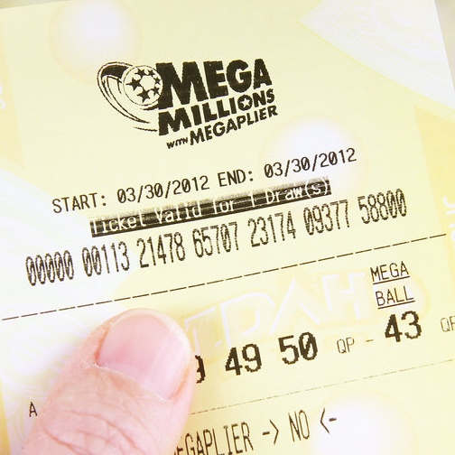
The Winning Lottery Ticket
“It won’t change me one bit!”

Slide 4
Credibility
Telling you I’m going to act in my best interest is not committing
To commit to a suboptimal action, I need to change the game.

Slide 5
“The difference between
genius and stupidity
is that genius has its limits.”
– Albert Einstein

Slide 6
Changing the Game
Reduce payoffs from strategies that tempt you. Make it costly to renege.
Remove strategies that may tempt you in the future. Destroy avenues of retreat.
Replace players or eliminate strategic control.

Slide 7
Changing the Game
Credibility requires the change to the game to be sufficient to ensure commitment.

Slide 8
“The difference between ‘involvement’ and ‘commitment’ is like ham and eggs breakfast. The chicken is ‘involved’;
the pig is ‘committed.’ “
– Martina Navratilova

Slide 9
Commitment vs. Involvement
Two firms considering market entry:
  Market potential is $10 million NPV profits
  Entry costs $7 million
Them
 |  | In | Out
Us | In | -2 , -2 | 3 , 0
 | Out | 0 , 3 | 0 , 0
  It is in our best interest to stay out if we think that the other firm will enter

Slide 10
Involvement
We make an initial investment:
  Invest first $1 million to deter entry
Them
 |  | In | Out
Us | In | -2 , -2 | 3 , 0
 | Out | -1 , 3 | -1 , 0
  It is still in our best interest to stay out if we think that the other firm will enter

Slide 11
Commitment
We make an initial investment:
  Invest first $3 million to deter entry
Them
 |  | In | Out
Us | In | -2 , -2 | 3 , 0
 | Out | -3 , 3 | -3 , 0
  It is our dominant strategy to go in.

Slide 12
Credible Commitment
By reducing our own payoffs from staying out, we have committed to entry
It is credible because it is now in our own best interest!

Slide 13
Strategic Moves
Actions taken prior to the play of the game
Transform the original game into a two-stage game:
  Setting the Rules
  Playing the Game

Slide 14
“Victorious warriors win first
and then go to war.
Defeated warriors go to war first and then try to win.”
– Sun Tzu

Slide 15
Strategic Moves
A strategic move must be
Credible
  Must change incentives
  Change strategies, payoffs, or players
  Observable
  Irreversible

Slide 16
Prisoner’s Dilemma
Equilibrium: $40 K
 |  |  | Firm 2
 |  |  | Low | High
Firm 1 |  | Low | 40 , 40 | 65 , 35
 |  | High | 35 , 65 | 60 , 60
Cooperation: $60 K

Slide 17
Joint Ventures &
Cross-Shareholding
If each firm acquires 20% of the other:
 |  | Low
High |  | 35 , 65
Firm 2:
(4/5) 65 + (1/5) 35
= 59
Firm 1:
(4/5) 35 + (1/5) 65
= 41
 |  | Low
High |  | 41 , 59

Slide 18
Joint Ventures &
Cross-Shareholding
Firm 2
 |  |  | Low | High
Firm 1 |  | Low | 40 , 40 | 65 , 35
 |  | High | 35 , 65 | 60 , 60
Firm 2
 |  |  | Low | High
Firm 1 |  | Low | 40 , 40 | 59 , 41
 |  | High | 41 , 59 | 60 , 60

Slide 19
Commitment & the Prisoner’s Dilemma
Practices that consumers love
but economists hate

Slide 20
Promises and Threats
Firms want to
  promise each other high prices
  threaten rivals who lower prices
But how to make promises and threats to a rival credible?
Contracts with third parties

Slide 21
The Bocchicchio Family
“Once a particularly ferocious branch of the Mafia in Sicily, it had become an instrument of peace in America.”
How can Michael invite Don Tessio for a meeting and guarantee that Don Tessio will not be harmed?

Slide 22
Customers as Hostages
Firms can contract with customers as a third party to make credible threats and promises

Slide 23
Prisoner’s Dilemma
Equilibrium: $40 K
 |  |  | Firm 2
 |  |  | Low | High
Firm 1 |  | Low | 40 , 40 | 65 , 35
 |  | High | 35 , 65 | 60 , 60
Cooperation: $60 K

Slide 24
Customers as Hostages
Promises
“I promise to keep prices high”
Most favored customer clause
    If I ever offer a lower price to any other
    customer, I will offer it to you as well

Slide 25
Customers as Hostages
Most favored customer clause
Imagine in period 1 both priced High
Firm 2
 |  |  | High
Firm 1 |  | Low | 65 , 35 | 65 customers @ $1
 |  | High | 60 , 60 | 30 customers @ $2

Slide 26
Customers as Hostages
In period 2, Low requires a $1 refund to 30 customers from last period
 |  | High
Low |  | 65 , 35
Firm 1:
65 – 30 = 35
 |  | High
Low |  | 35 , 35

Slide 27
Customers as Hostages
Firm 2
 |  |  | Low | High
Firm 1 |  | Low | 40 , 40 | 65 , 35
 |  | High | 35 , 65 | 60 , 60
Firm 2
 |  |  | Low | High
Firm 1 |  | Low | 10 , 10 | 35 , 35
 |  | High | 35 , 35 | 60 , 60

Slide 28
Customers as Hostages
Threats
“I will punish you if you lower prices”
Price Matching Guarantee
    If any competitor offers a lower price,
    I will match it.

Slide 29
Customers as Hostages
Price Matching Guarantee
 |  | High
Low |  | 65 , 35
 |  | Low
Low |  | 40 , 40

Slide 30
Customers as Hostages
Firm 2
 |  |  | Low | High
Firm 1 |  | Low | 40 , 40 | 65 , 35
 |  | High | 35 , 65 | 60 , 60
Firm 2
 |  |  | Low | High
Firm 1 |  | Low | 40 , 40 | 40 , 40
 |  | High | 40 , 40 | 60 , 60

Slide 31
Other Price Guarantees
What is the impact of:
“Drug companies should not be allowed to charge Americans more than Canadians”
China requests a “Most Favored Nation” clause with the United States
Walmart requires a price from suppliers that is no worse than it gives competitors

Slide 32
Customers as Hostages
Price matching guarantees and most favored customer clauses exploit exactly the factors that make price competition brutal:
  customer price sensitivity
  customer price awareness
  low customer switching costs

Slide 33
Increasing Search Costs (Theory)
It costs a consumer a transportation cost, t, to “visit” another firm
If consumers expect prices of p^{e}, how much should you charge?
  Can charge up to p^{e} + t
But, if you iterate this
        If you charge p^{e}+t, competitor can charge p^{e}+t+t,
        but then you can charge p^{e}+t+t+t, …

Slide 34
Increasing Search Costs (Implementation)
Prevent price advertising
    Government regulation (liquor stores)
    Industry agreement (likely illegal)
    Professional trade groups (doctors)
Limit store hours
    Closing laws (florists)
Obfuscate price information (Dilbert’s “confusopolies”)
    Make comparison difficult (mattresses, insurance)
    Use multiple prices (banking, auto dealers)

Slide 35
Strategic Moves
Understand incentives
Think creatively!

Slide 36
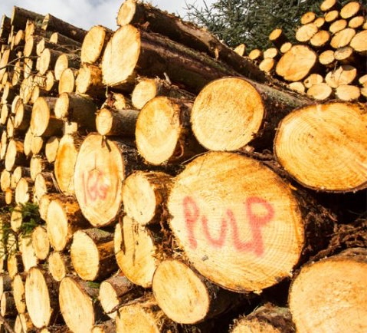
On Time Delivery
10 suppliers of wood pulp
Deliver on time: $70K cost
Deliver week late: $20K cost
Delivery payment is $100K
We need 9 suppliers

Slide 37

House Negotiations
“My husband
is a game theorist…”

Slide 38
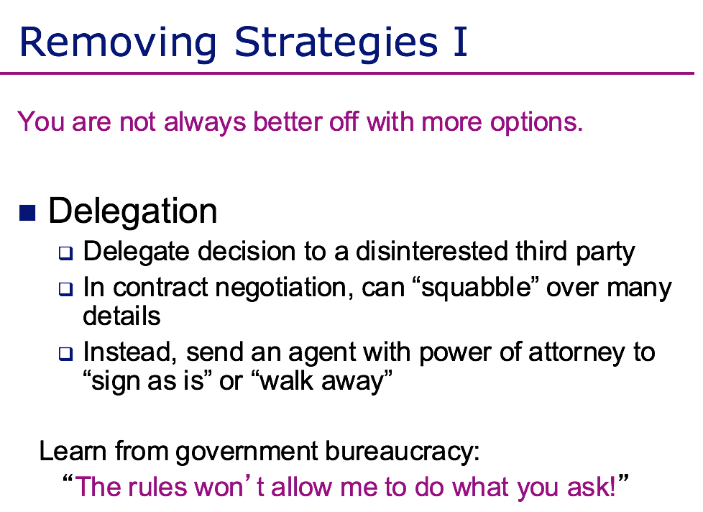

Slide 39
Commitment Under Uncertainty

Slide 40
An offer you can’t refuse
After a seemingly successful interview, the interviewer asks where the firm ranks on your list of potential employers.
Before answering, you are told:
  The firm only hires applicants who rank it first
  You must accept a job offer in advance, should one be made

Slide 41
An offer you can’t refuse
Why make such proposals?
    Take advantage of your uncertainty
    Take advantage of your risk-aversion
    Make you commit before they do!

Slide 42
Balance
Value of commitment
  Change in others’ behavior from your committing to some course of action generates value
Value of flexibility (option value)
  Keeping your options open allows you to react to changing situations (option value)

Slide 43

Evolution of Music Formats
Should Philips build CD disk-pressing plant in the United States (1992)
Should Apple develop an MP3 player? (2001)

Slide 44
Balance
Value of commitment
Value of flexibility

Slide 45
Philips Decision Making
Option value:
If a monopolist, build now if chance of mass acceptance > 36%
    Commitment:
    Given rival (Sony), build if chance of mass acceptance > 13%

