Slide 1
Game Theory
Spring 2026 - Mike Shor Topic 7

Slide 2
Outline…
Moral hazard & adverse selection
Incentive pay
Screening & Signaling

Slide 3
I like work.
It fascinates me.
I can sit and look at it for hours.
- Jerome Klapka Jerome

Slide 4
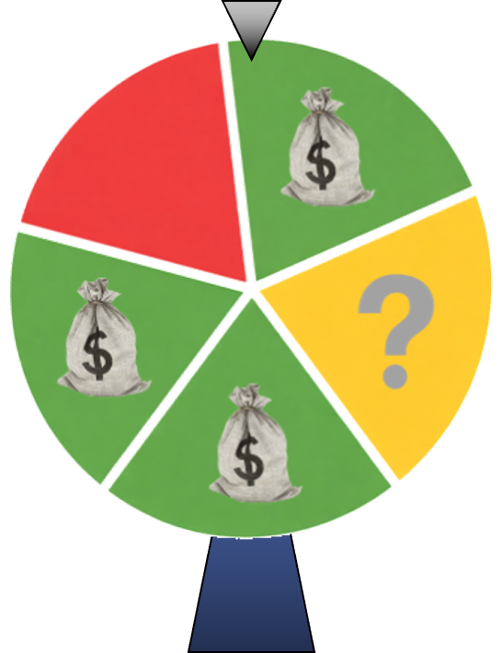
The (charity) Roulette Wheel
$50

Slide 5


Moral Hazard
You, a small pharmaceutical company, subcontract a large number of research projects (each with uncertain outcome)
Each research facility, if hired, can choose to put in either routine effort or high effort.
You don’t observe effort directly.

Slide 6
Moral Hazard
  Probability of success depends on firm’s effort
    routine effort: 60%
    high effort: 80%
  Firm has a cost of effort
    routine effort: $100,000 cost
    high effort: $150,000 cost
  Project value:
        $600,000 only if successful

Slide 7
Compensation Schemes
Benchmarks:
  Fixed Payment
  Observable Effort
Result-contingent bonus scheme

Slide 8
Incentive Scheme 1:
Fixed Payment
No amount of fixed payment can convince the firm to put in high effort.
Fixed payment must be high enough to get the firm to accept the project.

Slide 9
Fixed Payment
Optimal payment
  Lowest possible
  Firm requires $100,000
  Payment = $100,000
Expected Profit
    Expected project value – payment
    = (.6) $600K – $100K
= $360K - $100K = $260K

Slide 10
Incentive Scheme 2:
Observable effort
Observe effort contracts are simple:
  Work as hard as we tell you to, or else
Only question:
How hard do we want employees to work?
  Salary must be commensurate with level of effort, or no one will take the job

Slide 11
Observable effort
Pay and demand routine effort:
  Avg. Profit = (.6)600,000 – 100,000 = $260,000
Pay additional $50K for high effort:
  Avg. Profit = (.8)600,000 – 150,000 = $330,000
If effort is observable, pay for high effort
Expected Profit = $330K

Slide 12
Moral Hazard
Fixed payment can’t incent high effort
    Worst case: $260K
Observable effort is often not realistic
    Best case: $330K
How close can we get to best case scenario if effort is unobservable?

Slide 13

Incentive Scheme 3:
Fixed Payment & Bonus
Suppose effort can not be observed
Incentive-compatible compensation
  Compensation contract must rely on something that can be directly observed and verified.
Related probabilistically to effort
  E.g., project’s success or failure
  Imperfect but positive information

Slide 14
Fixed Payment & Bonus
Pharmaceutical company offers
  f: fixed base payment
  b: bonus if the project succeeds
Consider from subcontractor’s perspective
  What options does it have?

Slide 15
Fixed Payment & Bonus
Incentive Compatibility (high > routine)
    Putting in high effort
    must be better than
    putting in routine effort
Participation Constraint (high > none)
    Putting in high effort
    must be better than
    not taking the contract

Slide 16
Fixed Payment & Bonus
Subcontractor profit
  High effort: f + (0.8)b – 150K
  Routine effort: f + (0.6)b – 100K
  Not taking job: 0

Slide 17
Fixed Payment & Bonus
Incentive compatibility
  f + (0.8)b – 150K ≥ f + (0.6)b – 100K
  ⇒ b ≥ 250K
  ⇒ b = 250K
Participation Constraint
  f + (0.8)b – 150K ≥ 0
  ⇒ f + (0.8) (250K) ≥ 150K
  ⇒ f ≥ –50K
  ⇒ f = –50K

Slide 18
Incentive Pay
Bonus must guarantee that
  Marginal benefit of effort ≥ marginal cost of effort
Bonus depends on
    difference between low and high effort costs
    impact effort has on chance of success

Slide 19
Profit
    Worst case (fixed payment) scenario: $260K
    Best case (observable effort) scenario: $330K
Fixed payment and bonus profit:
= (.8)600,000 – (.8)b – f
    = (.8)600,000 – (.8)250,000 + 50,000
    = $330,000
Same as with observable effort!!!

Slide 20
Moral Hazard
It is possible (in theory) to design incentive schemes that fully resolve moral hazard
If done imprecisely, may be better not to bother

Slide 21
Challenges
Risk
Behavioral
Leakages
Groups

Slide 22
Risk
Incentive pay implies employees assuming risk for events out of their control.
Employees must be sufficiently compensated for this risk

Slide 23
Risk Risk Risk
Seeking Neutral Averse
Lottery Corporations
(small stakes) one-time deals
Multiple Insurance
Gambles (big stakes)

Slide 24
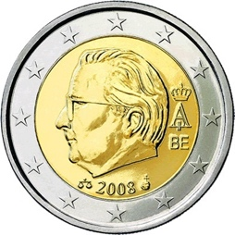
Would you bet $1000?
Chance of Loss
48%

Slide 25
Would you bet $100
10 times?
Chance of Loss
33%

Slide 26
Would you bet $1
1000 times?
Chance of Loss
10%

Slide 27

Behavioral Concerns
A new test for a horrible, painful, terminal disease
Rare: one in a million people
Accurate test:
  95% correct
  5% false positive/negative
You test positive!
How worried are you?

Slide 28
You can’t just tell people that you value them, you have to show them.
You can’t just show people that you value them, you have to tell them.

Slide 29
Leakages
If bonus is tied to
  Increases over last year
    → Reduce this year’s growth
  Output / Quantity
    → Reduce quality

Slide 30
Group incentives
A 19th century English traveler on a Chinese ferry was shocked at the ferocity with which an overseer whipped the oarsmen.

Slide 31
Incentive Pay
Enticing high effort is hard work
But, it is often worth it if can be done right

Slide 32
Adverse Selection

Slide 33
Screening
A screen is an effort by the less informed party to have the more informed party reveal his or her type
  Require an action or offer a menu of choices
  Must be observable and costly
  Must not be desirable for “bad” types to do

Slide 34
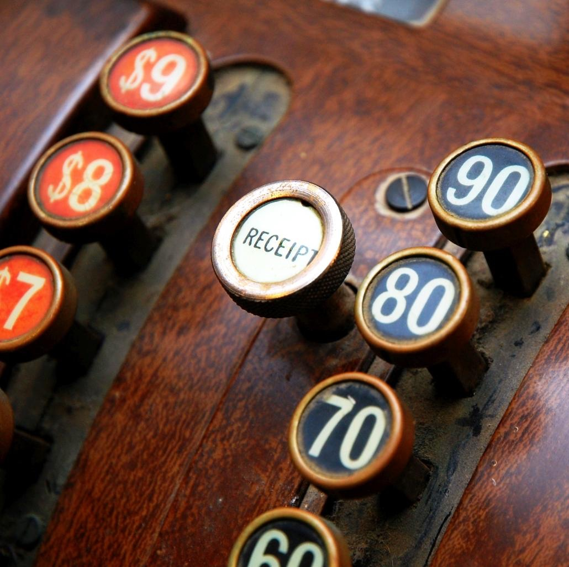
Screening
Are you a high value customer
or a low value customer?

Slide 35
Screening
In 1990, IBM released
the LaserPrinter E

Slide 36
Versioning
In the 1840s, third class train travel was horrendous!

Slide 37
What the company is trying to do is to prevent the passengers who can pay the second class fare from traveling third class;
It hits the poor, not because it wants to hurt them, but to frighten the rich.
— Jules Dupuit, engineer & economist, 1849

