Slide 1
Game Theory
Spring 2025 - Mike Shor Topic 8

Slide 2
Everything is worth what its purchaser will pay for it.
- Publilius Syrus
(Maxim 847, 42 B.C.)

Slide 3
Auctions
  auc·tion/ˈôkSH(ə)n/: a market institution
  with rules governing resource allocation
  on the basis of bids from participants

Slide 4
Auctions
  One third of US GDP moves through auctions
  Emissions permits
  Import quotas
  Mineral rights
  Radio Spectrum
  Procurement
  IPOs
  Wine
  Art
  Flowers
  Fish
  Electric power
  Treasury bills

Slide 5
Mistakes are the portals
of discovery
- James Joyce

Slide 6
Sample Auction
Up for auction: $20

Slide 7
Going Once…
Going Twice…
Bidding Starts at $1
Who will make
the first bid?

Slide 8
Auctions Overview
Auctions are a tricky business
Sources of uncertainty
  private vs. common value auctions
Auction mechanisms
  open auctions (ascending & descending)
  sealed auctions (1st price & 2nd price)

Slide 9
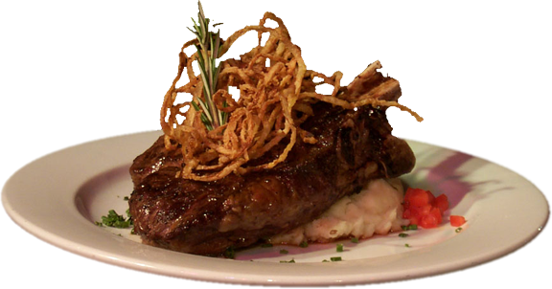
Private Value

Slide 10
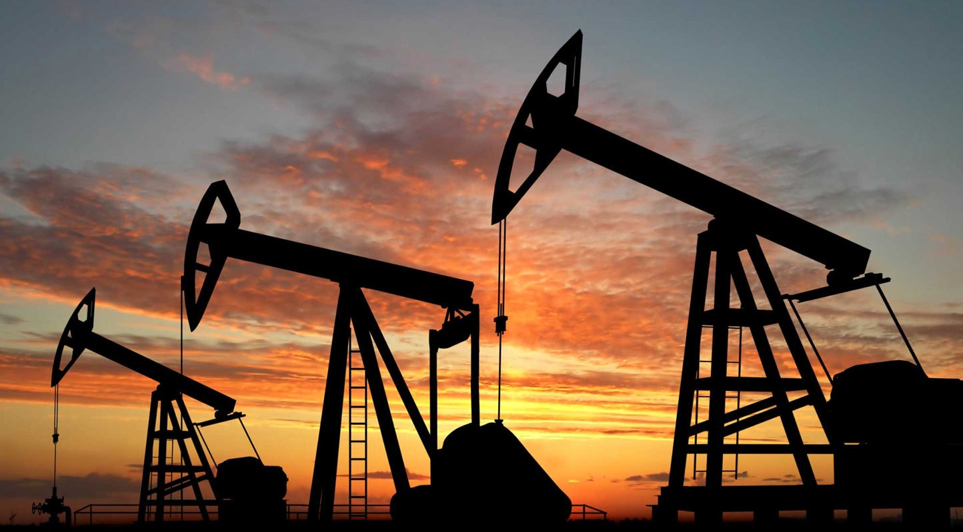
Common Value

Slide 11
Sources of Uncertainty
Private Value Auction
  Each bidder knows his or her value for the object
  Bidders differ in their values for the object
  e.g., memorabilia, consumption items
Common Value Auction
  The item has a single though unknown value
  Bidders differ in their estimates of the true value
  e.g., drilling rights, disciplinary corporate takeovers

Slide 12
Ascending Bid
English auction
Prices rise (through auctioneer or bidders)
  Bidders call out prices (outcry)
  Auctioneer calls out prices (silent)
  Bidders hold down button (Japanese)
Highest bidder gets the object
Pays a bit over the next highest bid

Slide 13
Descending Bid
Dutch (“Tulip”) auction
“Price Clock” ticks down the price
First bidder to “buzz in” is the winner
Pays price on clock

Slide 14
Dutch Auction

Slide 15
Sealed Bid (1st Price)
Buyer submitting the highest bid wins and pays the price he or she bid
WINNER! Pays $700
$700
$500
$400
$300

Slide 16
Sealed Bid (2nd Price)
Buyer submitting the highest bid wins and pays the second-highest bid.
WINNER! Pays $500
$700
$500
$400
$300

Slide 17
Why 2nd Price?
Strategically equivalent to an English Auction
$500
$400
$300

Slide 18
Bidding
2nd price auction:
  Bidding exactly your value is a dominant strategy
1st price auction:
  Bid less than your value
  How much? That’s hard.

Slide 19
Which is Better?
In a second price auction
  bidders bid their value
  auctioneer receives the second highest bid
In a first price auction
  bidders bid below their value
  auctioneer receives the highest bid

Slide 20
Revenue Equivalence
All popular auction formats yield the same expected revenue (in theory, with rational, risk-neutral bidders

Slide 21
Revenue Equivalence in the Real World
Risk Aversion
    Does not affect 2nd price auctions
    Risk averse bidders bid higher in 1st price auctions
    Risk aversion → 1st price or Dutch are better
Non-familiarity with auctions
    More overbidding in second-price auctions
    More overbidding in sealed-bid auctions
    Inexperience → 2nd price sealed bid is better

Slide 22
Designing Auctions
Every rule may have unintended consequences
    What is the minimum bid for a new bidder?
    How much must bids be beaten by?

Slide 23
Importance of Rules (eBay)
Three MacBook Pros for sale
Top three bidders pay the third highest bid
Opening bid: $1
Current high bids:
$50, $80, $400
How high should the next bid be?

Slide 24
Importance of Rules (FCC)
Discouraging Collusion
    Do not identify highest bidders
Capturing Surplus
    Do not set a bidding increment
“I bid $8,000,483”
“I bid $3,000,395”

Slide 25
Summary
Bidding:
  Bid true valuation in 2nd price auctions
  Shade bids in 1st price auctions
Designing:
  Take advantage of inexperience
  Take advantage of risk aversion
  Do sweat the little stuff

Slide 26
Sources of Uncertainty
Private Value Auction
  Each bidder knows his or her value for the object
  Bidders differ in their values for the object
  e.g., memorabilia, consumption items
Common Value Auction
  The item has a single though unknown value
  Bidders differ in their estimates of the true value
  e.g., drilling rights, disciplinary corporate takeovers

Slide 27
Oil Field Auction

Slide 28
Oil Field Auction
How much do you bid?

Slide 29
Winner’s Curse
If the average estimate is usually correct,
the highest estimate is usually too high

Slide 30



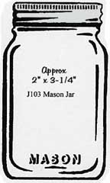


Winner’s Curse
Estimates are correct, on average
$40
$70
$50
$60
$80
$60

Slide 31
Winner’s Curse
Given that I win an auction …
All others bid less than me …
Thus the value must be lower than I thought
Winning the auction is “bad news”

Slide 32
Winner’s Curse
To avoid the winner’s curse, estimate the value conditional on winning the auction

Slide 33
Winner’s Curse
Bidding for a company of uncertain value

Slide 34
Summary
Since winning means you have the most optimistic estimate, always bid as if you have the highest estimate
Average value of an object is irrelevant
Consider only the conditional value if you win

Slide 35
“The greatest auction in history”
- New York Times, March 16, 1995, p.A17

