Slide 1
Managerial Economics
Fall 2017 - Mike Shor Lecture 1

Slide 2
I don’t skate to where the puck is.
I skate to where the puck
is going to be.
– Wayne Gretzky

Slide 3
Outline
Economics is the study of incentives
The rational actor paradigm
Problem solving: the three questions
The One Lesson of Business

Slide 4
Incentives

Slide 5
Lap children
Are children on an airplane safer in a parent’s lap
or in their own seat?

Slide 6
Administratrivia

Slide 7
Course Information
Textbook
Readings on Brightspace
Sample problems & interactive tutorials
Course discussion: come prepared

Slide 8
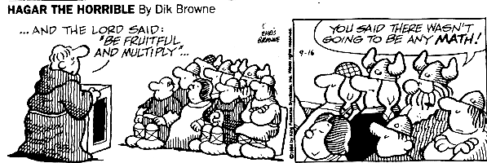
Disclaimer

Slide 9
Disclaimer

Slide 10
Weekly Quizzes
Available on Brightspace each week
Due by midnight Sunday
Multiple choice
Open book, open notes for this class only
Timed (so prepare ahead of time!)
Lowest quiz dropped. Best 6 (of 7) count.

Slide 11
Weekly Homework
Due by 2:00 pm Friday
Short answer
First, try on your own
You may discuss with classmates
Everything you turn in must be your own work
Lowest HW dropped. Best 5 (of 6) count

Slide 12
Grading
Quizzes (best 6 of 7) 15%
Homework (best 5 of 6) 35%
Participation (and extra credit) 10%
Final Exam 40%

Slide 13
Honor Code
Quizzes may not use any resources outside of current course notes and the textbook.
Homework may be discussed with classmates, but do not look at their answers.
Any outside sources must be cited.
Any questions? ASK!

Slide 14
Policies
They have a lovely
“No cell phone”
policy here…

Slide 15
Rational Actor Paradigm
People pursue their own interests.
They are perfect calculators.
They never make mistakes.

Slide 16
Baseball rationality
What is the optimal angle
to hit a baseball?

Slide 17
Problem Solving

Slide 18
The Three Questions
Who is making the (bad) decision?
Does the decision maker have enough information to make a good decision?
Does the decision maker have the incentive to make a good decision?

Slide 19
Solutions
Transfer decision making
Let someone with better info or incentives decide
Provide more information to decision maker
Change decision maker’s incentives
Performance measurement & reward

Slide 20
Solutions
There are rarely “solutions” to problems
There are different collections of tradeoffs

Slide 21
The One Lesson of Business

Slide 22
Wealth Principles
Wealth is created when assets move from lower- to higher- valued uses.
Efficiency implies all assets are at their highest-valued use.
Preventing voluntary transactions destroys wealth.
taxes, subsidies, price floors & ceilings

Slide 23
Price Regulation
Mismatch between buyers and sellers
Black markets
Lower incentive to supply

Slide 24
The One Lesson of Business
Identify assets in low-valued uses and devise ways
to profitably move them to high-valued ones.

Slide 25
Ethics
Economics is a very successful positive science.
Be wary of economists making normative statements.
Economics uncovers tradeoffs in different solutions.
The value of those tradeoffs is up to you!

Slide 26
Next Time …
Costs
Fixed, Variable, Accounting, Opportunity
Fallacies
Sunk costs, hidden costs

