Slide 1
Managerial Economics
Fall 2017 - Mike Shor Lecture 10

Slide 2
Last time…
Simultaneous games: corresponding best responses
Sequential games: look forward and reason back

Slide 3
Outline…
The prisoner’s dilemma
Other games
Bargaining
The (second) Aha! Moment

Slide 4
Prisoner’s Dilemma

Slide 5
Current (1988)
share price ≈ $60
Expected post-takeover
share price ≈ $60
Macy’s offers $70 / share
Contingent on 50%
The Battle for Federated
How to win a bidding war by bidding less?
Robert Campeau offers
$74 per share
not contingent on
amount acquired
If more than 50% tender:

Slide 6
 |  | Majority of Others
 |  | Macy’s | Campeau
You | Macy’s | 70 , 70 | 60 , 67+
 | Campeau | 74 , 70 | 67+, 67+

Slide 7
The Battle for Federated
Everyone tenders shares to Campeau
Resulting price: $67
But Macy’s offered $70!

Slide 8
The biggest, looniest deal ever.
— Fortune Magazine

Slide 9
Some Other Games
Prisoner’s Dilemma
Coordination
Assurance
Chicken

Slide 10
Coordination
Complementers
Must use same standard to profit
Each firm has a preferred standard
Example profits
100 if both use my preferred standard
50 if both use other standard
0 if use different standards

Slide 11
Assurance
Joint ventures
Each firm may invest or not invest
Project successful only if both invest
Example profits
$ 50K cost of investment
$125K revenues if successful
$ 0K revenues if not successful

Slide 12
Chicken
Entry into small markets
Profit potential only for one firm
If multiple firms enter, all suffer losses
Example profits
$100K if enter alone
−$ 50K if enter together
$ 0K if don’t enter

Slide 13
Bargaining
Strategic view: bargaining is just a game of chicken
(Worry about the rules)
Non-strategic view: equal sharing of surplus
(Worry about your outside option)

Slide 14
Game Theory
Spend as much time thinking about your opponent’s strategy as you do your own

Slide 15
Game Theory
Spend as much time thinking about your opponent’s strategy as you do your own
Doesn’t that mean thinking about what your opponent is thinking about your strategy?
Doesn’t that mean thinking about what your opponent is thinking about what you are thinking about your opponent’s strategy?
Doesn’t that mean thinking about what your opponent is thinking about what you are thinking about what your opponent is thinking about your strategy?

Slide 16
The Aha! Moment

Slide 17
A Game
Pick a number between 0 and 100
The person who selects a number closest to ¾ of the average wins!

Slide 18
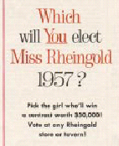
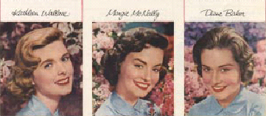

Slide 19
A Game
Picking 0
2 (in sec. 1), 3 (in sec. 2), 5 (in sec. 3)
In Section 1: Someone picked 67
In Section 2: Someone picked 75
Someone picked 91
In Section 3: Two people picked 77

Slide 20
A Game
Thirteen students picked 38
Or 37.5
Twelve students total picked 28
Or 28.1, Or 28.125

Slide 22
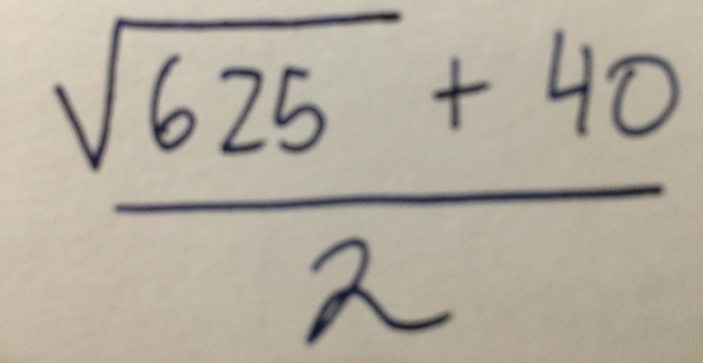
A Game
Eric
James

Slide 23
Results
Average Winning
Section 1: 26.59 19.94
Section 2: 28.38 21.28
Section 3: 27.57 20.68

Slide 24
Winners
Section 1:
UH 20
Section 2:
CR 21.2
Section 3:
AH 21.10

Slide 25
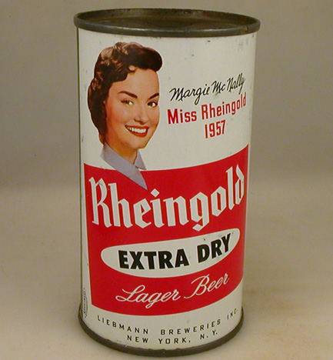

Slide 26
One Step Ahead
If we all knew the exact date of the next major market correction, when would you sell your holdings?
IPO Lockup Expiration

Slide 27
Increased supply after the lock-up expiration
will drive price down.
It is simply economics of supply and demand.
— Wall Street Journal

Slide 28
“Expect volatility and declines today as the smart money gets out before tomorrow’s lock-up expiration
— CNBC

Slide 30
Summary
People think two to three steps
Most people have an Aha! Moment
The winner thinks one step ahead…

