Slide 1
Managerial Economics
Fall 2017 - Mike Shor Lecture 11

Slide 2
Last time…
Game theory: how our decisions depend on others

Slide 3
Outline…
Risk and uncertainty: how our decisions depend on luck
Auctions

Slide 4
Risk and Uncertainty

Slide 5
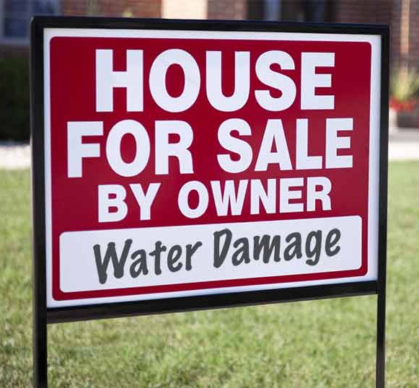
Formerly $250,000 home
Can buy for $150,000
Hope to resell for $200,000
Cost of damage repair:
Minor: Major
$20,000 $100,000
(75%) (25%)
Hurricane Harvey
$200 billion in damages
Many houses sold at deep discounts sight unseen
Is purchasing a portfolio of such houses likely to be profitable?
How much is an inspection worth?

Slide 6
Expected Value
Identify all states of the world by their profit
E.g., economy good/bad; rain/shine; patent/no
Must be mutually exclusive and exhaustive
Assign (subjective) probabilities to each
Must sum to 1, or to 100%
Calculate the weighted average
Use the probabilities as your weights

Slide 7
Hurricane Harvey
Purchasing such houses has an expected profit of $10,000 per house
How much is an inspection worth?

Slide 8
Caveats
Are probabilities known with certainty?
Of course not! Do sensitivity analysis.
Are you facing risk or uncertainty?
Is expected value reasonable behaviorally?
Are you being influenced by frames?

Slide 9
Risk vs. Uncertainty
10 balls: red
20 balls: green or orange
Decision 2
Option A: $100 if you draw a red or orange ball
Option B: $100 if you draw a green or orange ball
Decision 1
Option A: $100 if you draw a red ball
Option B: $100 if you draw a green ball

Slide 10
Expected Value, Behaviorally
Heads: you get $2
Tails: I flip again
Heads: you get $4
Tails: I flip again
Heads: you get $8
Tails: I flip again
Etc.
Flipping a coin
Start with $2
Every tails doubles $
First heads: I pay you
How much would you
pay to play this game?

Slide 11
Framing
Which do you prefer?
Option A: A sure gain of $240
Option B: A 25% chance of winning $1000
and a 75% chance of winning $0
Option A: A sure loss of $760
Option B: A 75% chance of losing $1000
and a 25% chance of losing $0

Slide 12
Risky Decisions
A good decision is good or bad a priori
Bad luck does not imply a bad decision
Employees often fear ex post outcomes
Act too cautiously
How to offer proper incentives?

Slide 13
Customer Values & Risk
Single item, two potential customers
Each customer has value of $80 or $100
Each value equally likely
Marginal cost is $20
What price should I set?

Slide 14
Auctions
“Everything is worth what its purchaser will pay for it.”
- Publilius Syrus (Maxim 847, 42 B.C.)

Slide 15
Auctions
One third of US GDP moves through auctions
Wine, art, flowers, fish, electric power
Emissions permits, import quotas, mineral rights
Different auction mechanisms
Sequential: Open (Ascending & Descending)
Simultaneous: Sealed-Bid (1st price & 2nd price)

Slide 16
Ascending Bid
English auction
Prices rise (through auctioneer or bidders)
Highest bidder gets the object
Pays a bit over the next highest bid

Slide 17
Descending Bid
Dutch auction
“Price Clock” ticks down the price
First bidder to “buzz in” is the winner
Pays price on clock

Slide 18
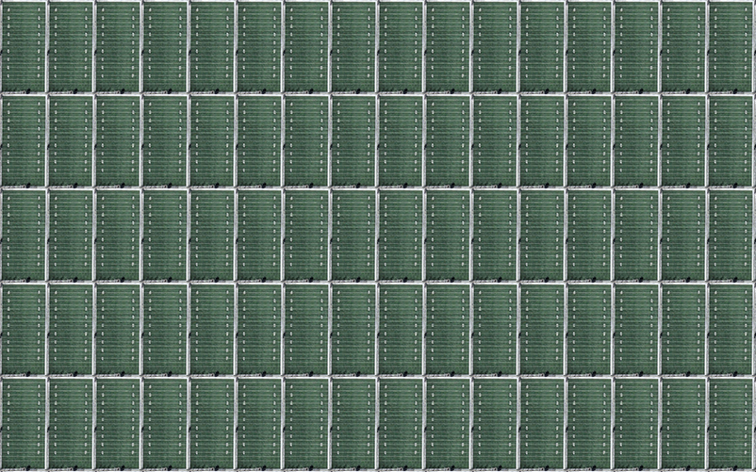
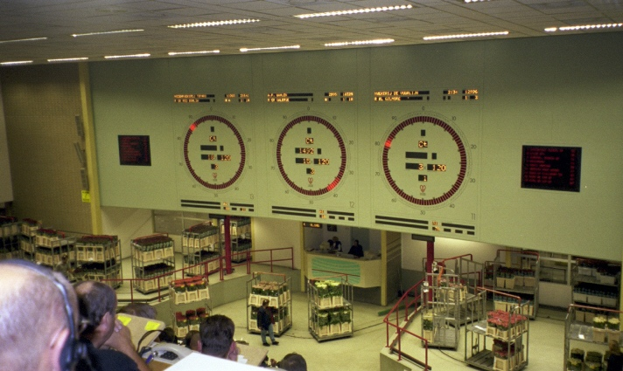
Dutch Auction
$ 10
$120
$ 20
$110
$ 30
$100
$ 40
$ 90
$ 50
$ 80
$ 60
$ 70

Slide 19
Sealed Bid (1st Price)
Buyer submitting the highest bid wins and pays the price he or she bid
WINNER! Pays $700
$700
$500
$400
$300

Slide 20
Sealed Bid (2nd Price)
Buyer submitting the highest bid wins and pays the second-highest bid.
WINNER! Pays $500
$700
$500
$400
$300

Slide 21
Bidding
2nd price auction:
Bid exactly your value
1st price auction:
Bid less than your value
How much? That’s hard.

Slide 22
Summary
Expected value replaces value when there is risk or uncertainty
Auctions allow bidders to reveal their values, potentially leading to higher profits

